Slide 1



Mechanism to monitor delay in wage payments in Telangana
DEPARTMENT OF RURAL DEVELOPMENT
GOVT. OF TELANGANA

Slide 2

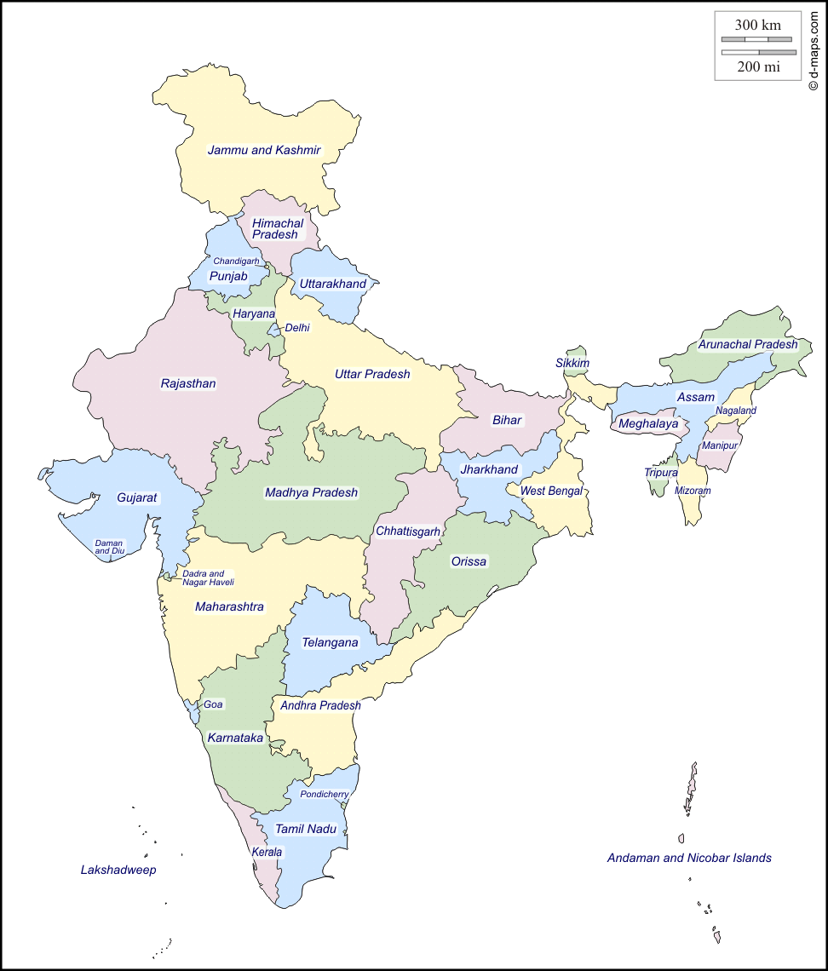
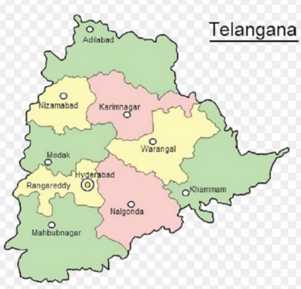
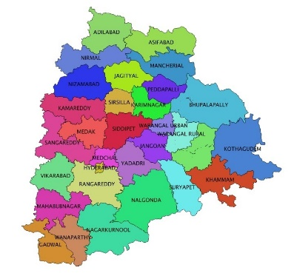
MGNREGS in Telangana
30 Districts; 438 mandals; 8517 GPs
56 lakh registered jobcards.
1.3 Cr registered wageseekers.
38 lakh active jobcards & 60 lakh active wageseekers
SC Jobcards: 12.56 lakhs (22%)
ST Jobcards: 8.7 lakhs (16%)
3.8 lakh SSS labour groups with 76 lakh wageseekers covering 32 lakh households

Slide 3
Timely payments – Provisions
Section 3 of MGNREGA - disbursement of daily wages shall be made on a weekly basis and in any case not later than a fortnight of the date of closure of muster.
Schedule II, para 29 (1) - wage seekers are entitled to receive payment of compensation for the delay, at the rate of 0.05% of the unpaid wages per day of delay beyond the sixteenth day of closure of muster roll.
As per para 29 1(b), states shall divide the processes leading to determination and payment of wages into various stages and specify stage-wise maximum time limit.
29,1(c) – Automatic calculation of compensation
29,1(d) – Payment of compensation upfront by State govt. after verification & recovery from functionaries or agencies
29, 1(f) – Compensation payable & paid to be in MIS

Slide 4
Status of wage payments
*lakh transactions

Slide 5
Measures to curb delay in wage payments
Process improvement.
Use of Technology
Rules and guidelines.
Close monitoring.

Slide 6
Process improvement

Slide 7
Key processes
Application for work – Through eMMS(Mobile App)& RAGAS(Web Application)
Uploading of photographs & Measurements through mobile
Payment Generation based on attendance & measurements
FTOs Uploading - Transfer of funds after approval of PO
Wage Payments (Banks/ Postal through Biometric )
Allotment of Work( through Mobile App) & Generation of eMusters
Uploading of daily attendance through Mobile / Manual Attendance
Work Execution based on eMusters

Slide 8
Grouping of wageseekers
Grouping of wageseekers into Srama Shakti Sanghas:
  Fixed Labour Groups – Demand & Allocation
  Muster Management – Efficient; Transparent
  Daily attendance – Mate Role
  Timely closure of musters – Measurements
  Electronic Musters – Prepopulated names – Unique ID
  Generation of Payments – Group wise

Slide 9
Gram Panchayats division
Division of Gram Panchayats into 2 categories based on geographical location:
  Batch I: Muster commences on Monday & closes on Saturday
  Batch II: Muster commences on Thursday & closes on Wednesday
GPs assigned to Technical Assistants such that 50% GPs assigned are of Batch I and 50% are Batch II
Enables TAs to capture measurement within 3 days of muster closure. (Captures measurements by Wednesday for Batch I & by Saturday for Batch II)
Engineering Consultants can check measure assigned works within 2 days.
Generation of payorders within timeline – as the GPs are divided & musters handed over on different dates for 2 batches.
Wednesday meeting with all functionaries – Review of musters – handing over filled in musters / issue of new musters

Slide 10
Dedicated field staff
Exclusive Staff:
  Dedicated EGS staff
  Clearly defined role
  Regular trainings
  Close monitoring
  Coordination with paying agencies
  Performance Appraisal – Key Parameters in renewal of contracts.
  Mobile advance to all staff with 100% recovery in monthly installments.
Field Assistants
Demand & Allocation of Work;
Musters Management; Uploading of Attendance;
Supports Technical Assistants while measurements
Technical Assistants
Measurements & Uploading of photographs
Collects musters from field and handover M-Book along with musters at MCC
Engineering Consultant
Check measures works
Uploads images with coordinates
Handover M-Book with check measurements to APO
Computer Operators
Monitors musters issued & musters filled-in
Verifies filled in musters
Ensures generation of payorders – Coordinates all staff incl. paying agencies
All online transactions
Addl. Programme Officer
Issues electronic musters
Generates payments based on musters & m-books
Supports Programme Officers

Slide 11
Use of technology

Slide 12
Effective use of ICT
Web Application:
-Customized Online Application
-Capturing data from field
eFMS.
-No parking of funds – No shortage
eMMS
-Simplified screens
-Minimum data entry
-Populating the data in RAGAS
-Attendance / Measurements captured
-Enables faster generation of payorders
-Prepopulated information
– eMusters / Measurements
-Online transfer of funds
-Mode: CBS, Postal, -Transfer of wages into A/c within a day
-Biometric authenticated payments

Slide 13
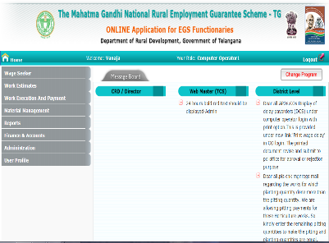
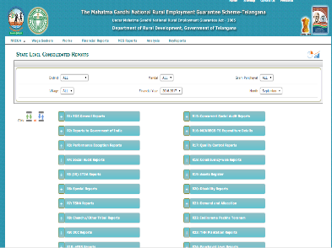
Web application: ragas
  Transaction based Web Application- www.nrega.telangana.gov.in
Demand capture, work allocation, e-Muster, Muster entry, Payorder generation, FTO upload.
Daily reports, weekly reports, monthly reports.
Special monitoring reports on Muster status.
Exception reports for monitoring of delayed musters.

Slide 14
Mobile applications
  Android based mobile applications.
  FA/GRS every week collects the demand for work from SSS group members, then uploads the same demand details through mobile app.
  Work allocation to the demanded groups through mobile app by FA.
  Geo coordinates, photo and Measurements upload by TA.
  Check measurement details uploads by the EC.

Slide 15
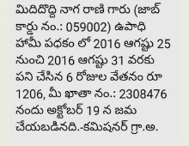
SMS alerts
More than 5 Cr SMSes sent to wageseekers / field functionaries / officials
Alerts on wage payments to wageseekers about depositing the wage payments.
Alerts on performance/pending musters/instructions to field functionaries / officials.
Scheduled alerts – Auto generated – Triggered directly from Web application.
Support of CDAC

Slide 16
Delay compensation system
Rules and guidelines

Slide 17
History of dcs
DCS is in implementation in Andhra Pradesh (united) from July 2011.
Functionary-wise activities and timelines fixed.
Initially DCS was @ 0.3% – subsequently changed to 0.1%
Currently, DCS is calculated @ 0.05% per day as per the Act.
Rs 11.9 Cr paid as compensation since 2012 due to delay of functionaries / paying agencies.
Rs 4 Cr paid as compensation by the Govt. during 2015-16 & 2016-17 due to delay in releases.

Slide 18
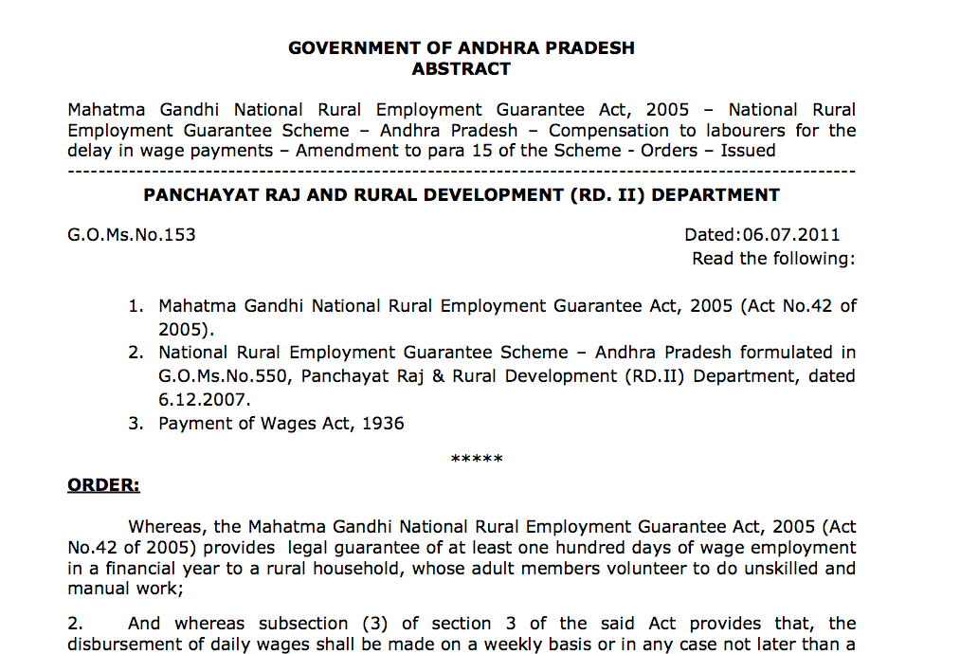
Delay compensation rules

Slide 19
Timelines for dcs in Telangana
Measurements by Technical Assistant (T1= T+3) –
Muster Closure to M-Book handing over date with measurement
Check Measurement by Engineering Consultant (T2=T1+2=T+5) – Measurement date to Mbook Handing over Date with check measurements
Payment Generation by Computer Operator (T3= T2+2= T+7)M-Book received date to Payment Generation date
FTO Uploading by Programme Officer (T4=T3+2=T+9)
Payment generation to FTO Uploading date
Wage Disbursement by paying agencies (T5=T4+4=T+13)
FTO Uploading date to actual disbursement
PART - I
PART - II

Slide 20
Dcs in Telangana
Calculated for wage payments delayed beyond 15 days of muster closure.
Functionary wise no. of days delayed ascertained.
Functionaries tagged to respective mandals & GPs.
Each payment captures details of functionaries & time period.
Calculation of DCS based on delays by the concerned.
DCS calculated separately for Functionaries & Paying agencies:
  Functionaries – Upto Uploading of Fund Transfer Orders
  Paying Agencies – Upto actual disbursement of wages
Approval of DCS by the Project Director

Slide 21
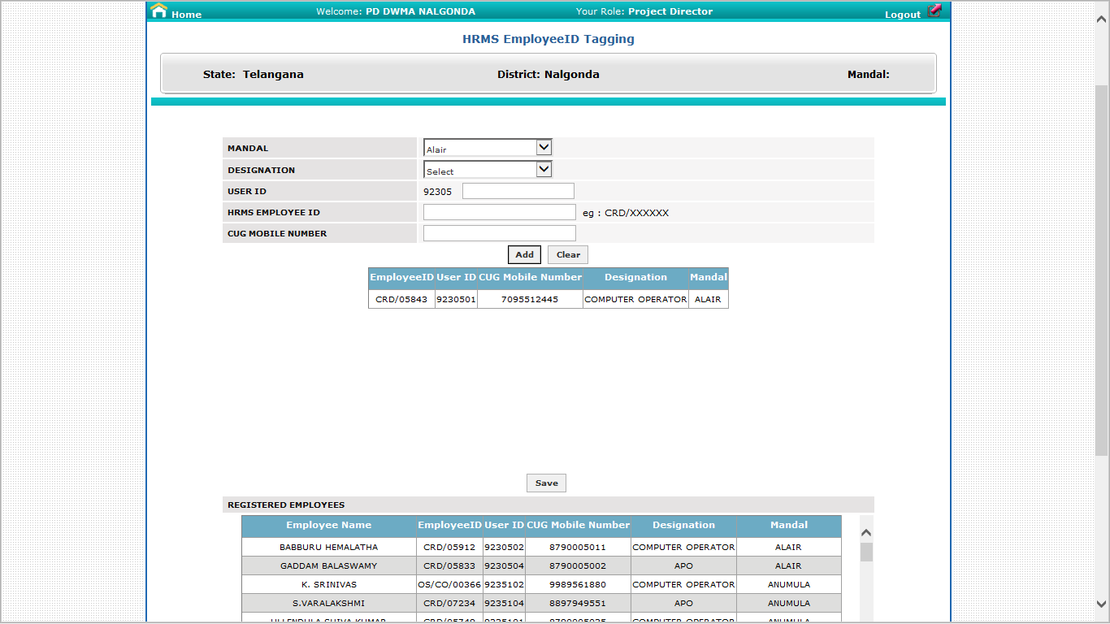
Tagging of functionaries

Slide 22
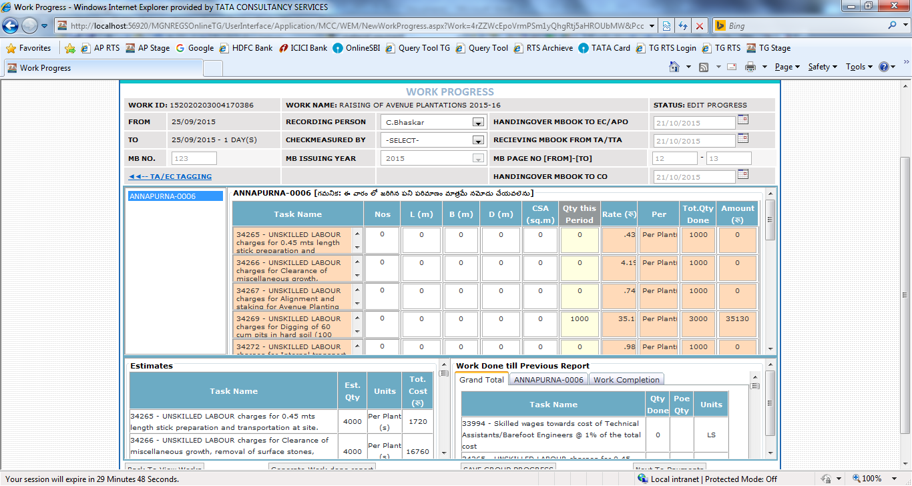
Capturing measurement dates

Slide 23
Uploading Remarks for delay
Software provision in RAGAS at mandal level
Online submission of reasons for delay
The uploaded reasons reflects in Project Director’s login, who decides on final recoveries
The reasons include:
      Software issues
      Hardware & Network issues
      Others.

Slide 24
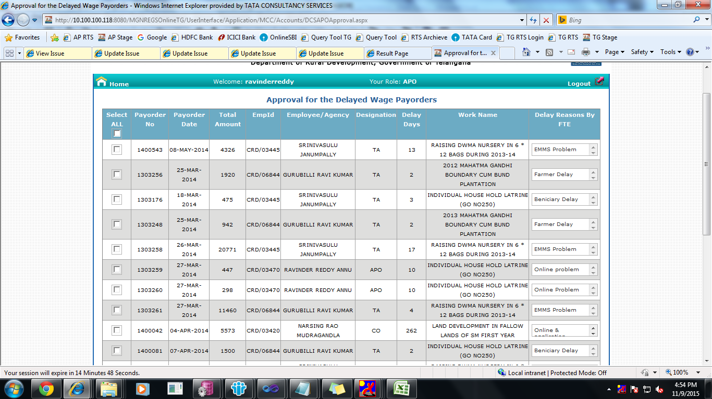
reasons uploaded by functionaries

Slide 25
Decision on DCS Recoveries
Payorder wise data provided in the PD’s login for decision.
Decision on approvals & recoveries by Project Directors
Approval / dis-approval within 15 days of pushing data to PD login (i.e., after uploading of FTO) or else auto approved.
PD has to decide the DCS related to functionaries.
DCS for paying agencies is based on actual disbursement date.
Compensation paid to wageseekers based on approval & paid upfront.
Subsequently recovered from salaries of functionaries / service charge of paying agencies.

Slide 26
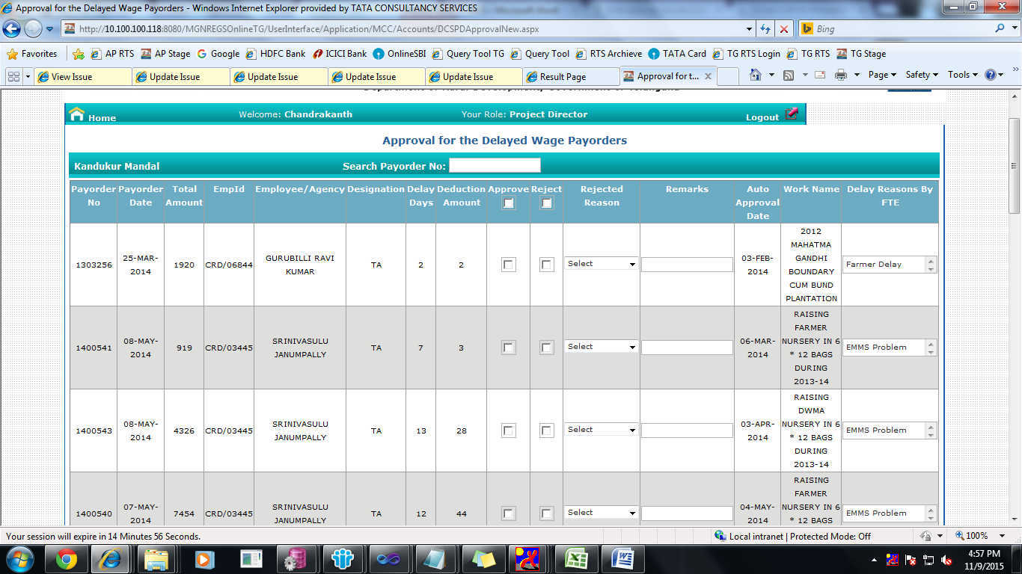
Online approval of dcs

Slide 27
Payment of compensation – Recoveries
Compensation to wageseekers is made with the next wage payment under separate head – ‘compensation for delayed wages’
Compensation paid upfront by the State Govt.
Recovery from functionaries in instalments. Max 1/3rd salary in a month is recoverable.
In case of paying agencies, recovery made from service charges i.e., 2%.

Slide 28
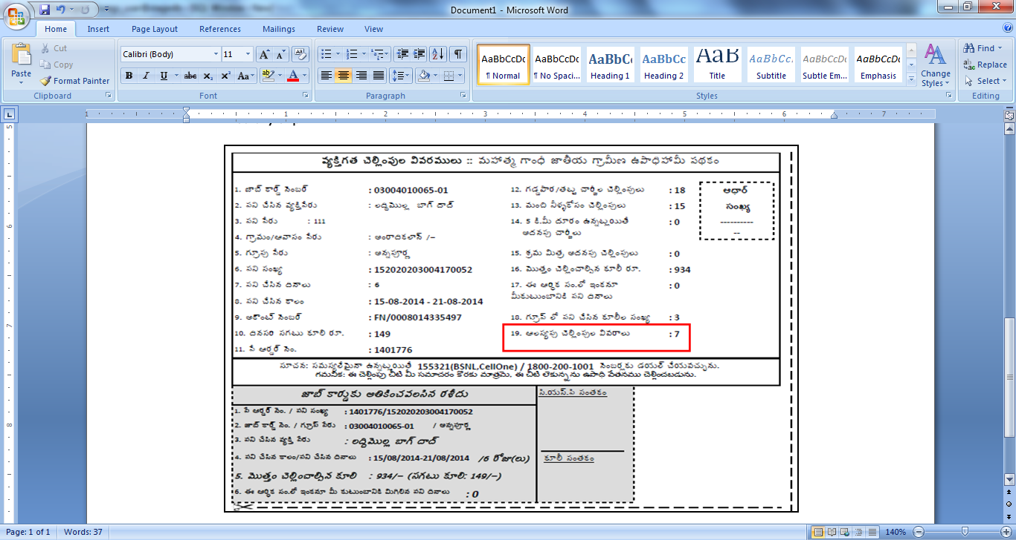
Wage slip

Slide 29
Recoveries from functionaries

Slide 30
Monitoring mechanism

Slide 31
Monitoring mechanism
Weekly Video Conferences : Pending musters, payments is compulsory agenda
Special Officers( from State office) to each district to monitor and solve the issues.
Wednesday meeting with all functionaries at Mandal level – Ascertaining status of pending payments
Regular meetings with Postal department and Bankers.
SMS to wageseekers about depositing wage payments, and to staff on pending musters, FTOs.
Use of MIS reports- to monitor delay musters, payments at all levels.

Slide 32
Monitoring mechanism……
Payments monitoring cell at State & district level – DBT Wing
Daily monitoring and reconciliation for FTOs generated, uploaded, rejected FTOs and daily monitoring of disbursement of wages by Postal dept.
Call center – Grievance Redressal : 1 800 200 1001
Strict implementation of Delay Compensation System (DCS) in spite of pressures from various associations.
Filling up the staff vacancies and IT requirements on priority basis in the potential wage demand areas.
Various WhatsApp groups, Telegram groups at all levels to address the issues in time.

Slide 33
Challenges in ensuring timely payments
Remote areas / Tribal areas / Sparsely located villages
Hardware issues – Infrastructure
Network issues – Interior Areas
Peak working season – Jan to July
Actual cash disbursements at village level – Physical movement of cash
Vacancies of Staff /BPMs
DCS – Delay in decisions – Auto approved recoveries – Concerns from functionaries / Paying agencies

Slide 34
THANK YOU
DEPARTMENT OF RURAL DEVELOPMENT
GOVT. OF TELANGANA

