Slide 1

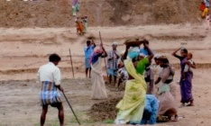
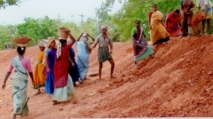
Performance Review Committee (PRC)
17th January, 2017
Notes:
1

Slide 2
Thanks…

Slide 3
Achievements of FY 2016-17so far
168 cr persondays generated till 31st Dec, 2016. which is 6% more than the approved LB till Dec, 16.
About 61.5% of expenditure on the works related to NRM so far: 58% was the achievement last FY.
Nearly 70% of total expenditure so far on activities related to agriculture and allied sector: 63% in last FY.
Highest ever release/ sanction till 16th January, 2017 (Rs. 42,576 Cr).
About 8.67 cr Aadhaar seeded in MIS (80%) out of total 10.86 cr active workers and 3.91 cr workers on ABP system.

Slide 4
Achievements of FY 2016-17so far
GeoMGNREGA- about 33 lakh Assets Geotagged.
Jobcard Verification going on in full swing.
Adoption of 7 Registers
About 48 lakh works completed (36% of taken up): highest ever
21 States and 1 UT on NeFMS- Rs. 13,888 Cr as wages.
Farm pond : 4.26 lakh completed and 6.12 lakh ongoing
Training of Barefoot Technicians- 80 number of batches undergoing training.
Mission Water Conservation Workshops

Slide 5
Items
Persondays (PDs) generation
Progress in Focus Areas
GeoMGNREGA
Emphasis on NRM & Agriculture
Individual Assets (Category-B)
Completion of incomplete works
Timely wage payment
Aadhaar, eFMS & Capacity Building (Digital Payment)
Jobcard verification/ Updation

Slide 6
Items
Adoption of 7 Registers
Social Audit
BFT
Citizen Information Board/ Wall writing
DTRT & BTRT Training
LIFE
Research Studies
Mapping of Manual Casual Labour as per SECC
Planning FY 2017-18
Pending C&AG Para
Pending Parliamentary Assurance

Slide 7
Persondays (PDs) Generation

Slide 8
PDs Generation (Performance against LB till 31st Dec, 16)
National:
Total LB: 221 Cr
LB till Dec, 16: 159 cr
PDs till Dec, 16: 168 cr (106%)

Slide 9
GPs with no expenditure

Slide 10
Progress of
Focus Areas

Slide 11
Farm Ponds
No. | State | Farm Ponds (as on 16/01/2017)
 |  | Target (FY 16-17) | Ongoing | Completed | %age completed
1 | MAHARASHTRA | 1000 | 22659 | 4749 | 474.90
2 | UTTAR PRADESH | 5705 | 26978 | 7383 | 129.41
3 | HARYANA | 61 | 345 | 74 | 121.31
4 | TELANGANA | 25000 | 52931 | 22375 | 89.50
5 | ANDHRA PRADESH | 250000 | 170288 | 209442 | 83.78
6 | RAJASTHAN | 25000 | 47108 | 18892 | 75.57
7 | HIMACHAL PRADESH | 10361 | 10724 | 7177 | 69.27
8 | JHARKHAND | 128132 | 106500 | 80767 | 63.03
9 | MEGHALAYA | 300 | 162 | 182 | 60.67
10 | ODISHA | 20340 | 9515 | 10150 | 49.90
11 | KERALA | 5000 | 2759 | 1651 | 33.02
12 | MADHYA PRADESH | 50000 | 9561 | 13506 | 27.01
13 | WEST BENGAL | 88948 | 61369 | 23165 | 26.04
14 | ARUNACHAL PRADESH | 1108 | 393 | 224 | 20.22
15 | JAMMU AND KASHMIR | 1885 | 1836 | 353 | 18.73
16 | UTTARAKHAND | 3814 | 3916 | 487 | 12.77
17 | TAMIL NADU | 17500 | 1077 | 2176 | 12.43
18 | CHHATTISGARH | 55000 | 17885 | 6579 | 11.96
19 | KARNATAKA | 111340 | 48153 | 12082 | 10.85
20 | BIHAR | 15000 | 8662 | 1286 | 8.57
21 | GUJARAT | 27516 | 3448 | 2304 | 8.37
22 | MIZORAM | 2131 | 565 | 155 | 7.27
23 | TRIPURA | 18700 | 1202 | 894 | 4.78
24 | MANIPUR | 2724 | 367 | 104 | 3.82
25 | ASSAM | 13239 | 3613 | 194 | 1.47
26 | NAGALAND | 603 | 112 | 3 | 0.50
27 | PUNJAB | 1581 | 38 | 5 | 0.32
28 | ANDAMAN AND NICOBAR | 307 | 0 | 0 | 0.00
29 | GOA | 25 | 12 | 0 | 0.00
30 | PUDUCHERRY | 5 | 10 | 0 | 0.00
31 | LAKSHADWEEP | - | 3 | 0
32 | SIKKIM | - | 0 | 2
 | Total | 882325 | 612191 | 426361 | 48.32

Slide 12
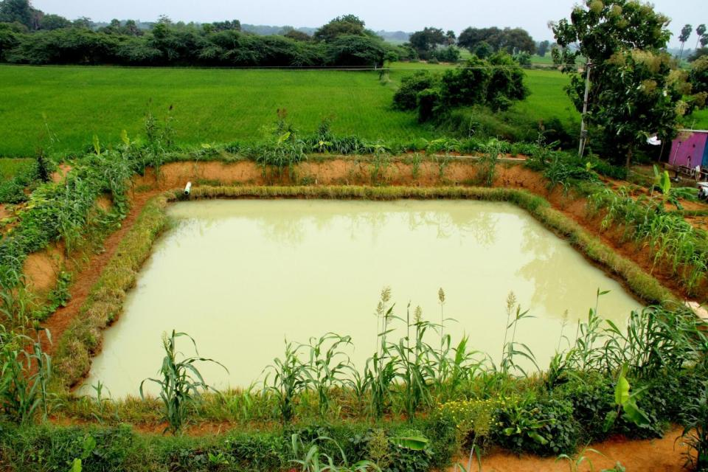
Farm Pond, Tamil Nadu

Slide 13
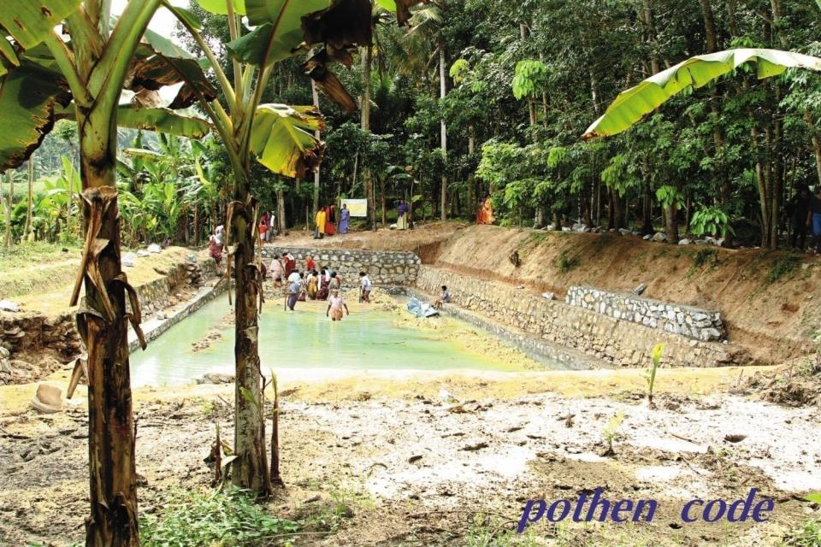
Thudikotukonam Pond; Village Puliveedu; District Thiruvananthapuram, Kerala

Slide 14
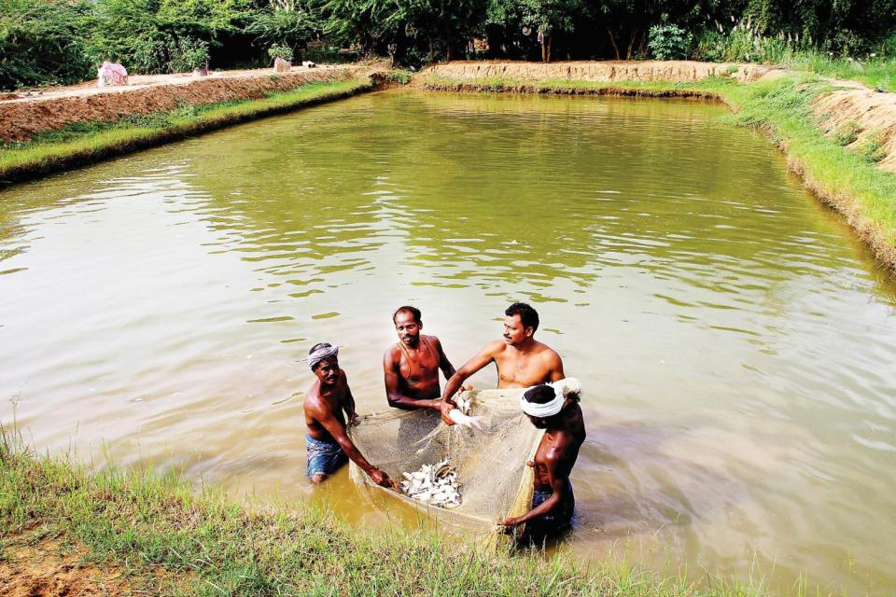
Fish rearing; Village Thottakadu; Block Thanjavur; District Thanjavur, Tamil Nadu

Slide 15
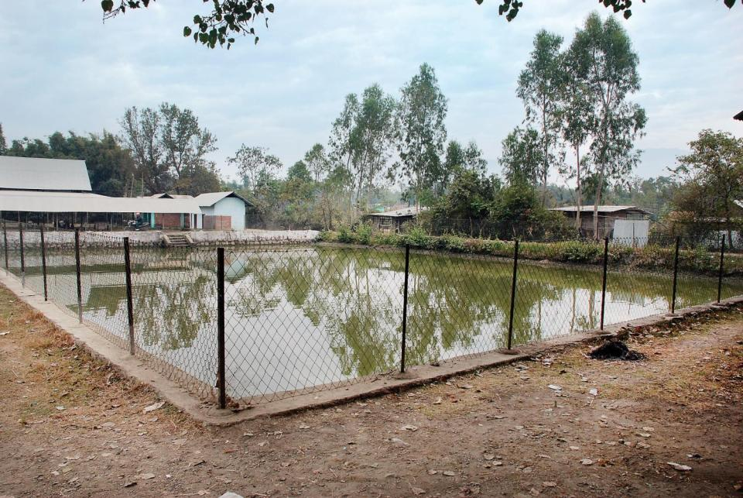
Pond; Village Ngarang Bam Makha, Leikai; Block Imphal West-1; District Imphal West, Manipur

Slide 16
IHHL
No. | State | IHHL (as on 16/01/2017)
 |  | Target (FY 16-17) | Ongoing | Completed | %age completed
1 | JHARKHAND | 25095 | 26803 | 22345 | 89.04
2 | CHHATTISGARH | 80000 | 238893 | 53150 | 66.44
3 | GUJARAT | 75000 | 154043 | 41358 | 55.14
4 | MAHARASHTRA | 64015 | 45776 | 20363 | 31.81
5 | ANDHRA PRADESH | 500000 | 154508 | 143425 | 28.69
6 | ARUNACHAL PRADESH | 1194 | 754 | 314 | 26.30
7 | KERALA | 6431 | 4303 | 1456 | 22.64
8 | MEGHALAYA | 2513 | 3391 | 524 | 20.85
9 | UTTAR PRADESH | 189293 | 109902 | 31290 | 16.53
10 | TELANGANA | 300000 | 207279 | 49102 | 16.37
11 | HIMACHAL PRADESH | 12821 | 4647 | 2047 | 15.97
12 | TAMIL NADU | 750000 | 79475 | 111037 | 14.80
13 | UTTARAKHAND | 49468 | 50269 | 5458 | 11.03
14 | WEST BENGAL | 350000 | 223183 | 34920 | 9.98
15 | HARYANA | 20000 | 1338 | 1962 | 9.81
16 | JAMMU AND KASHMIR | 47770 | 9579 | 3593 | 7.52
17 | ODISHA | 200000 | 93953 | 13539 | 6.77
18 | MIZORAM | 4647 | 1245 | 287 | 6.18
19 | TRIPURA | 119236 | 36457 | 6907 | 5.79
20 | BIHAR | 231000 | 57784 | 6959 | 3.01
21 | PUNJAB | 7825 | 184 | 51 | 0.65
22 | MANIPUR | 24018 | 699 | 123 | 0.51
23 | ASSAM | 222733 | 5726 | 228 | 0.10
24 | ANDAMAN AND NICOBAR | 950 | 5 | 0 | 0.00
25 | GOA | 400 | 0 | 0 | 0.00
26 | NAGALAND | 14935 | 1040 | 0 | 0.00
27 | KARNATAKA | -- | 10400 | 11813
28 | LAKSHADWEEP | -- | 0 | 0
29 | MADHYA PRADESH | -- | 46847 | 63507
30 | PUDUCHERRY | -- | 0 | 0
31 | RAJASTHAN | -- | 13789 | 21110
32 | SIKKIM | -- | 0 | 0
 | Total | 3299344 | 1582272 | 646868 | 19.61

Slide 17
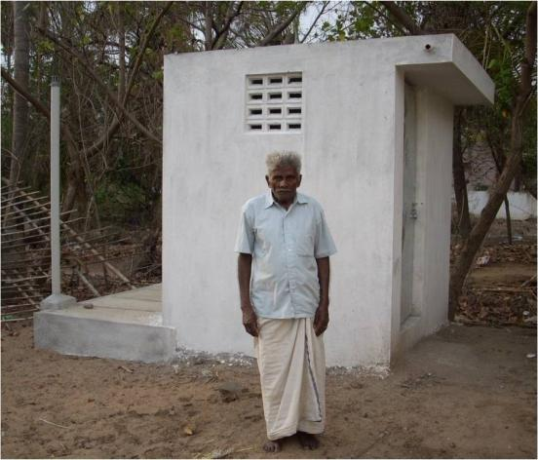
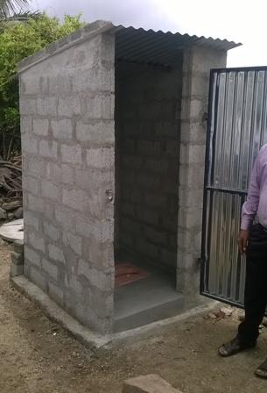
Individual Household Latrines (IHHL), Tamil Nadu

Slide 18
Aanganwadi Kendras (AWC)
No. | State | AWC (as on 16/01/2017)
 |  | Target (FY 16-17) | Ongoing | Completed | %age completed
1 | TAMIL NADU | 1000 | 1395 | 1188 | 118.80
2 | ODISHA | 4500 | 6937 | 1391 | 30.91
3 | TRIPURA | 300 | 380 | 73 | 24.33
4 | HIMACHAL PRADESH | 90 | 29 | 15 | 16.67
5 | CHHATTISGARH | 2000 | 2599 | 278 | 13.90
6 | ARUNACHAL PRADESH | 500 | 305 | 50 | 10.00
7 | NAGALAND | 74 | 41 | 6 | 8.11
8 | ANDHRA PRADESH | 2628 | 4162 | 136 | 5.18
9 | UTTARAKHAND | 1209 | 919 | 56 | 4.63
10 | RAJASTHAN | 2000 | 1157 | 86 | 4.30
11 | MADHYA PRADESH | 12000 | 2945 | 425 | 3.54
12 | KARNATAKA | 2432 | 1489 | 65 | 2.67
13 | UTTAR PRADESH | 10759 | 5946 | 203 | 1.89
14 | MIZORAM | 172 | 42 | 3 | 1.74
15 | JAMMU AND KASHMIR | 445 | 44 | 4 | 0.90
16 | HARYANA | 200 | 0 | 1 | 0.50
17 | PUNJAB | 1063 | 236 | 5 | 0.47
18 | WEST BENGAL | 6212 | 1081 | 29 | 0.47
19 | KERALA | 720 | 23 | 3 | 0.42
20 | MEGHALAYA | 790 | 5 | 1 | 0.13
21 | BIHAR | 1000 | 432 | 1 | 0.10
22 | ASSAM | 5884 | 335 | 2 | 0.03
23 | ANDAMAN AND NICOBAR | 26 | 0 | 0 | 0.00
24 | GUJARAT | 33 | 3 | 0 | 0.00
25 | JHARKHAND | 6000 | 219 | 0 | 0.00
26 | MAHARASHTRA | 289 | 0 | 0 | 0.00
27 | MANIPUR | 36 | 0 | 0 | 0.00
28 | PUDUCHERRY | 5 | 0 | 0 | 0.00
29 | SIKKIM | 100 | 12 | 0 | 0.00
30 | TELANGANA | 1064 | 117 | 0 | 0.00
31 | GOA |  | 0 | 0
32 | LAKSHADWEEP |  | 0 | 0
 | Total | 63531 | 30853 | 4021 | 6.33

Slide 19
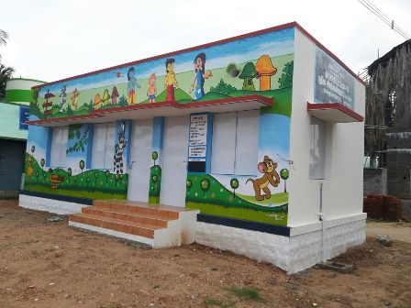
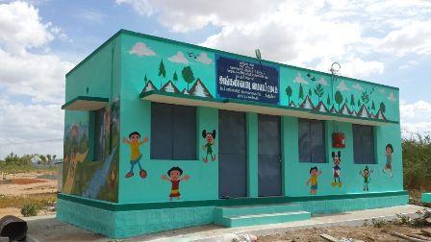
Aaganwadi Kendras (AWC),
Tamil Nadu

Slide 20
Vermi/ NADEP Composting
S.No. | State | Vermi / NADEP Compost (as on 16/01/2017)
 |  | Target (FY 16-17) | Ongoing | Completed | %age completed
1 | ANDHRA PRADESH | 200000 | 51805 | 69224 | 34.61
2 | TELANGANA | 40000 | 2900 | 10157 | 25.39
3 | ARUNACHAL PRADESH | 1800 | 483 | 351 | 19.50
4 | MIZORAM | 3000 | 699 | 346 | 11.53
5 | WEST BENGAL | 133083 | 145503 | 9547 | 7.17
6 | TAMIL NADU | 385 | 35 | 22 | 5.71
7 | MAHARASHTRA | 40000 | 10337 | 2023 | 5.06
8 | UTTARAKHAND | 10747 | 9781 | 430 | 4.00
9 | KARNATAKA | 25000 | 7266 | 752 | 3.01
10 | MADHYA PRADESH | 100000 | 7422 | 1271 | 1.27
11 | CHHATTISGARH | 52960 | 4202 | 550 | 1.04
12 | HIMACHAL PRADESH | 23363 | 1792 | 222 | 0.95
13 | UTTAR PRADESH | 90052 | 9328 | 719 | 0.80
14 | GUJARAT | 12986 | 152 | 98 | 0.75
15 | ODISHA | 40000 | 2368 | 151 | 0.38
16 | HARYANA | 381 | 73 | 1 | 0.26
17 | ASSAM | 19006 | 893 | 35 | 0.18
18 | JHARKHAND | 65000 | 110 | 109 | 0.17
19 | KERALA | 82099 | 613 | 101 | 0.12
20 | RAJASTHAN | 30000 | 1325 | 29 | 0.10
21 | MEGHALAYA | 20000 | 448 | 9 | 0.05
22 | BIHAR | 40000 | 8235 | 10 | 0.03
23 | TRIPURA | 5000 | 463 | 1 | 0.02
24 | ANDAMAN AND NICOBAR | 24 | 0 | 0 | 0.00
25 | GOA | 25 | 0 | 0 | 0.00
26 | JAMMU AND KASHMIR | 888 | 3 | 0 | 0.00
27 | MANIPUR | 2155 | 143 | 0 | 0.00
28 | NAGALAND | 133 | 35 | 0 | 0.00
29 | PUDUCHERRY | 3 | 0 | 0 | 0.00
30 | PUNJAB | 462 | 69 | 0 | 0.00
31 | SIKKIM | 1000 | 2 | 0 | 0.00
32 | LAKSHADWEEP |  | 0 | 0
 | Total | 1039552 | 266485 | 96158 | 9.25

Slide 21
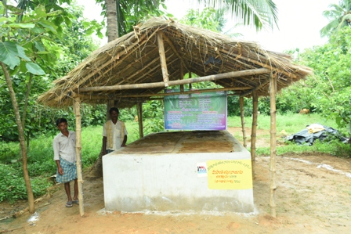
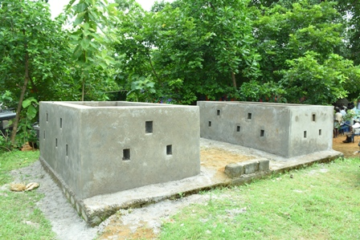
Vermi Compost Tank, AP

Slide 22
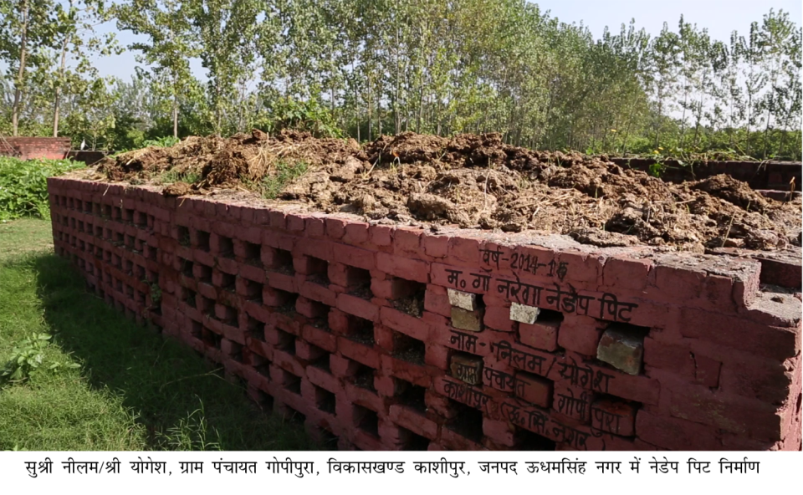
Nadep compost pit; Village Gopipura; Block Kashipiur; District Udhamsingh Nagar, Uttarakhand Name of beneficiary: Smt Neelam / Shri Yogesh

Slide 23
Roadside plantation

Slide 24
Roadside tree plantation
54 % target achieved for Roadside Tree Plantation
So far along the roadsides, 33000 beneficiaries identified for the maintenance of plantation and provision of usufruct rights
Mapping of data for PMGSY Roads (till District level) from OMMAS (PMGSY) with NREGASoft (MGNREGS) completed. States to edit and complete data entry pertaining to PMGSY Roads, by selecting the Code/Name of the PMGSY Road on which plantation was conducted in the FY 2016-17

Slide 25
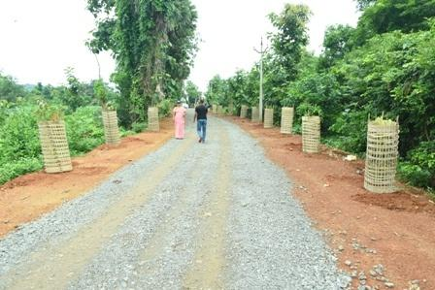
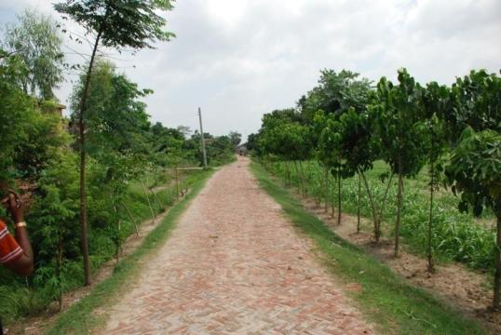
Roadside Plantation: AP
Roadside Plantation:
Muzaffarpur, Bihar

Slide 26
Geo-MGNREGA

Slide 27
National Statistics
Work Completed : 2,72,27,176
Assets pushed to
Bhuvan for Geotagging : 1,12,39,076 (42.18%)
Registration Completed :
Moderated Geotags: 35,49,571 (13% of Total work Completion)
Accepted Geotags: 33,27,874 (12% of Total work Completion )
No. of Blocks | No. of GAS | Percentage | No. of Panchayats | No. of MSE | Percentage
6,849 | 6,940 | 101 % | 2,62,440 | 2,75,762 | 106%

Slide 28
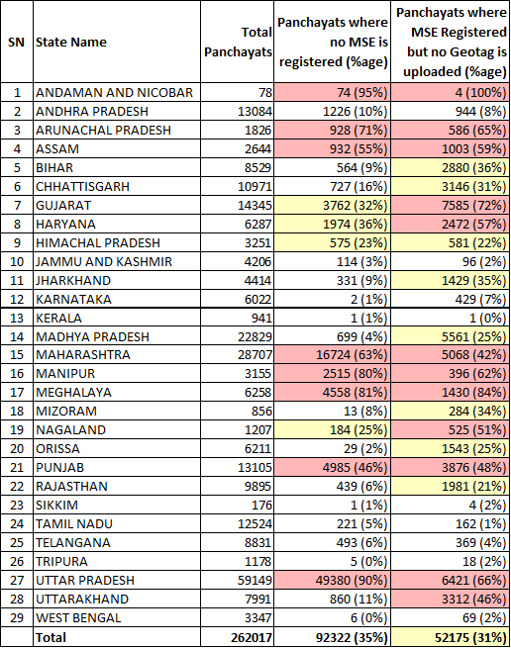
Gram Panchayat Coverage
262440

Slide 29
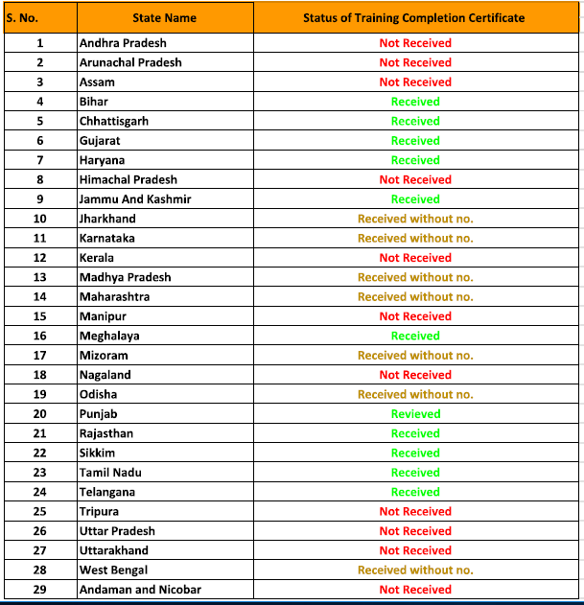
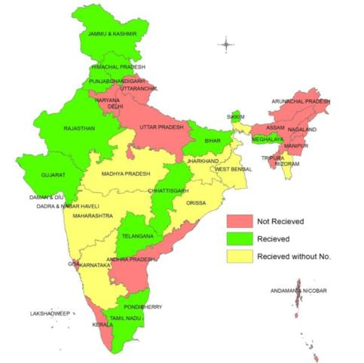
Training Certification Status

Slide 30
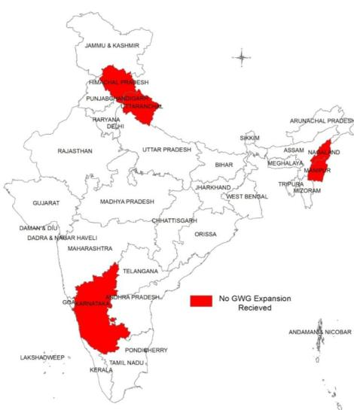
GWG Expansion Status
GeoMGNREGA Working Group expansion is yet not received from the following states :-
S. No. | States
1 | Himachal Pradesh
2 | Uttarakhand
3 | Karnataka
4 | Nagaland
5 | Manipur

Slide 31
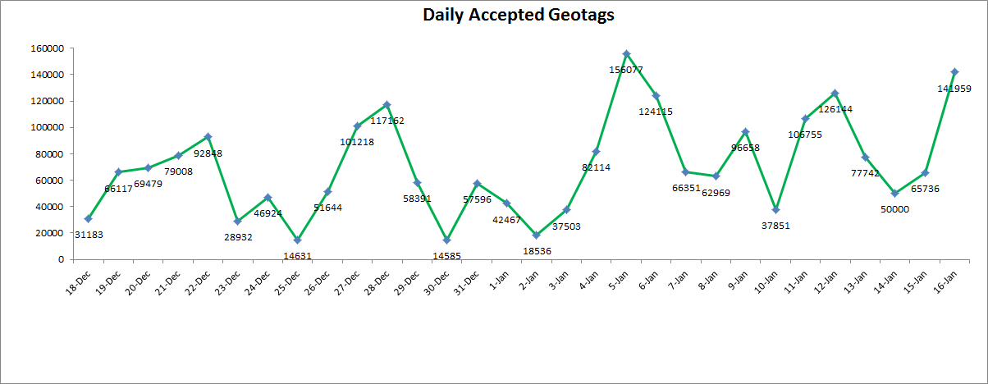

Slide 32
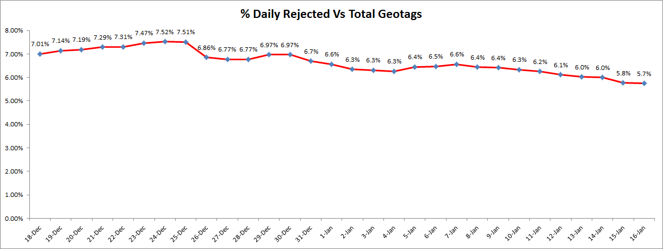

Slide 33
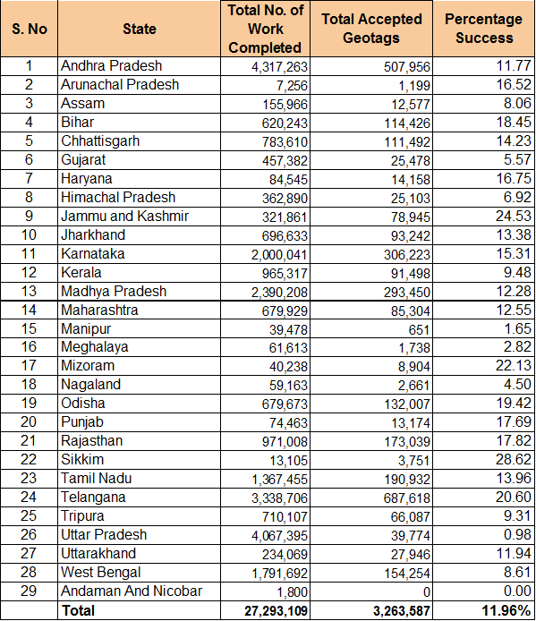
State Target and achievement so far
27,227,176

Slide 34
Support
Frequently Asked Questions are available at http://mord.geomgnrega.in/ and updated regularly on the basis of day to day experience and considering future requirements.
For any clarification write to GeoMGNREGA team at team@geomgnrega.in with detail.
Standard Operating Manual (SoM)
GeoMGNREGA Watch whatsapp group is open for discussions regarding GeoMGNREGA

Slide 35
Challenges
Missing Photograph - An intermediate solution is provided wherein the photos are recovered in 24 hours. The NRSC team is continually working on permanent solution.
Modification in unregistered Geotags and Statistical Reports
Duplicate Geotagging - An asset can be multiple time Geotagged and approved by GAS. There was no check at MSE level on asset data already geotagged and uploaded to the bhuvan server from the mobile application.

Slide 36
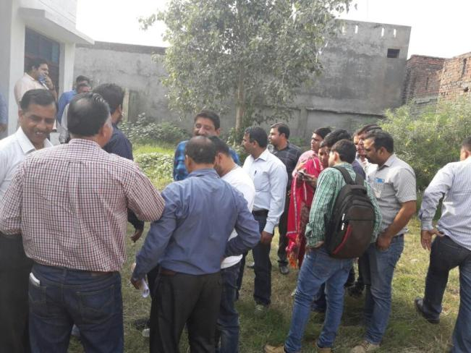
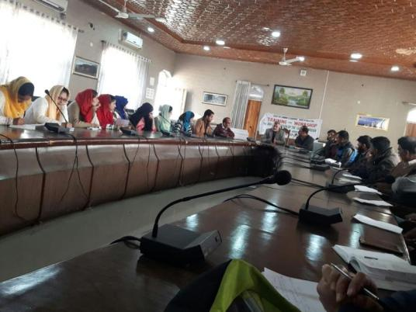
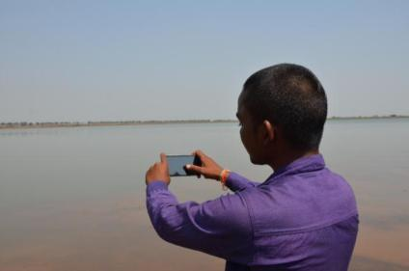
Field demonstration of Geo tagging of Assets, Rajauri, J& K
Geo MGNREGA training Anantnag
Geo tagging of Assets, Chhattisgarh

Slide 37
Emphasis on
NRM & Agriculture

Slide 38
Mission Water Conservation
112 districts categorized as ‘Irrigation Deprived’
Grim situation due to over utilization of groundwater - 1068 Blocks and 217 Blocks categorized as Over Exploited Blocks and Critical Blocks respectively
During current year, 155 districts from 25 states received less than 75% of the average rainfall
There is a need for paradigm shift from Relief Work approach to Integrated Natural Resource Management (INRM) approach in implementation of MGNREGS
Planned and systematic development of land and harnessing of rainwater following watershed principle s should be become central focus of MGNREGS to sustainably enhance farm productivity and income of poor people.
Systematic identification, planning and implementation of projects is highly recommended as it leads to creation of sustainable and productive assets for the community.

Slide 39
Mission Water Conservation
District shall be the synergizing unit for convergent planning under the leadership of District Collector.
The DPC/Collector will ensure that the Natural Resource Management component of Labour Budget of MGNREGS is essentially made part of the District Irrigation Plan (DIP)
Technical inputs while planning, will be drawn from the joint pool of technical personnel of IWMP in Watershed cum Data Centre, MGNREGA unit, Water Resource Department , Agriculture Department and Regional Office of Central Water Commission (CWC)
The State Remote Sensing Centre should also be requested to extend full support to State Rural Development Departments for planning process.
Atleast 65% of expenditure is on NRM works from FY 2017-18 in the water stressed and irrigation deprived districts & blocks.

Slide 40
Mission Water Conservation- Convergence Workshops
Conducted* | Proposed | Not Conducted
Andhra Pradesh, Assam Gujarat Haryana Jammu & Kashmir Jharkhand Karnataka, Madhya Pradesh Maharashtra Mizoram Odisha Punjab Sikkim Tripura Uttarakhand | Rajasthan - 19/01/2017 Himachal Pradesh – 3rd Week of Jan, 17 Kerala – Between 10th to 20th Feb 2017 West Bengal – 6th Feb 2017 Tamilnadu- (Feb, 2017) Telangana- (Feb, 2017) | Arunachal Pradesh Bihar Chhattisgarh Himanchal Pradesh Manipur Meghalaya Nagaland Uttar Pradesh
* Reports on State Level Workshops awaited from States in RED

Slide 41
NRM works
S No. | State | Expenditure on All works [In Cr] | Expenditure on NRM works [In Cr] | %age of expenditure on NRM works
1 | ANDHRA PRADESH | 3206.38 | 2169.28 | 67.7
2 | ARUNACHAL PRADESH | 89.05 | 34.46 | 38.7
3 | ASSAM | 1241.00 | 529.73 | 42.7
4 | BIHAR | 1705.04 | 766.33 | 44.9
5 | CHHATTISGARH | 2273.03 | 1281.18 | 56.4
6 | GOA | 2.11 | 1.75 | 83.0
7 | GUJARAT | 533.84 | 332.14 | 62.2
8 | HARYANA | 214.28 | 139.02 | 64.9
9 | HIMACHAL PRADESH | 345.38 | 234.50 | 67.9
10 | JAMMU AND KASHMIR | 472.86 | 197.11 | 41.7
11 | JHARKHAND | 1221.30 | 979.21 | 80.2
12 | KARNATAKA | 2050.11 | 1305.46 | 63.7
13 | KERALA | 1666.45 | 1462.03 | 87.7
14 | MADHYA PRADESH | 2469.90 | 1485.67 | 60.2
15 | MAHARASHTRA | 1672.03 | 1103.94 | 66.0
16 | MANIPUR | 275.84 | 186.38 | 67.6
17 | MEGHALAYA | 577.04 | 226.51 | 39.3
18 | MIZORAM | 62.80 | 45.11 | 71.8
19 | NAGALAND | 430.55 | 152.35 | 35.4
20 | ODISHA | 1714.31 | 907.71 | 53.0
21 | PUNJAB | 459.88 | 238.54 | 51.9
22 | RAJASTHAN | 3696.91 | 1914.69 | 51.8
23 | SIKKIM | 91.31 | 52.28 | 57.3
24 | TAMIL NADU | 4436.83 | 3303.51 | 74.5
25 | TELANGANA | 1503.61 | 905.58 | 60.2
26 | TRIPURA | 872.40 | 547.25 | 62.7
27 | UTTAR PRADESH | 3512.99 | 2319.14 | 66.0
28 | UTTARAKHAND | 561.14 | 297.36 | 53.0
29 | WEST BENGAL | 5402.03 | 3120.14 | 57.8
30 | ANDAMAN AND NICOBAR | 0.01 | 0.00 | 0.0
31 | LAKSHADWEEP | 0.00 | 0.00 | 0.0
32 | PUDUCHERRY | 8.17 | 7.79 | 95.3
Cells are in RED if the values are less than National Average
National percentage on NRM: 61.5%

Slide 42
Exp. on Agriculture & Allied Works
S No. | State | Total Exp. (Rs. In cr) | Exp. on Agri. & Allied Works (Rs. In cr) | Percentage
1 | LAKSHADWEEP | 0.0008 | 0.0008 | 100.0
2 | KERALA | 1139.38 | 1110.93 | 97.5
3 | PUDUCHERRY | 9.77 | 9.34 | 95.7
4 | GOA | 2.24 | 1.92 | 85.6
5 | JHARKHAND | 1216.93 | 1039.43 | 85.4
6 | SIKKIM | 70.39 | 58.29 | 82.8
7 | MIZORAM | 157.92 | 127.91 | 81.0
8 | KARNATAKA | 2022.95 | 1615.82 | 79.9
9 | TAMIL NADU | 4519.69 | 3551.32 | 78.6
10 | UTTAR PRADESH | 2577.14 | 1948.19 | 75.6
11 | MAHARASHTRA | 1419.07 | 1070.66 | 75.5
12 | MADHYA PRADESH | 1736.44 | 1300.61 | 74.9
13 | HIMACHAL PRADESH | 337.11 | 248.35 | 73.7
14 | HARYANA | 182.22 | 133.82 | 73.4
15 | MANIPUR | 284.99 | 199.15 | 69.9
16 | WEST BENGAL | 3395.14 | 2372.63 | 69.9
17 | ODISHA | 1241.29 | 844.50 | 68.0
18 | ANDHRA PRADESH | 3668.18 | 2442.21 | 66.6
19 | GUJARAT | 450.75 | 295.87 | 65.6
20 | TRIPURA | 873.41 | 562.87 | 64.5
21 | RAJASTHAN | 3100.64 | 1934.76 | 62.4
22 | UTTARAKHAND | 398.28 | 245.74 | 61.7
23 | TELANGANA | 1440.11 | 853.40 | 59.3
24 | CHHATTISGARH | 1765.71 | 950.52 | 53.8
25 | NAGALAND | 456.03 | 244.48 | 53.6
26 | BIHAR | 1278.80 | 639.08 | 50.0
27 | PUNJAB | 355.32 | 166.18 | 46.8
28 | JAMMU AND KASHMIR | 325.72 | 143.29 | 44.0
29 | ASSAM | 896.55 | 383.12 | 42.7
30 | ARUNACHAL PRADESH | 96.41 | 39.76 | 41.2
31 | MEGHALAYA | 376.52 | 152.66 | 40.6
32 | ANDAMAN AND NICOBAR | 3.18 | 0.00 | 0.0
 | Total | 35798.26 | 24686.82 | 70.0

Slide 43
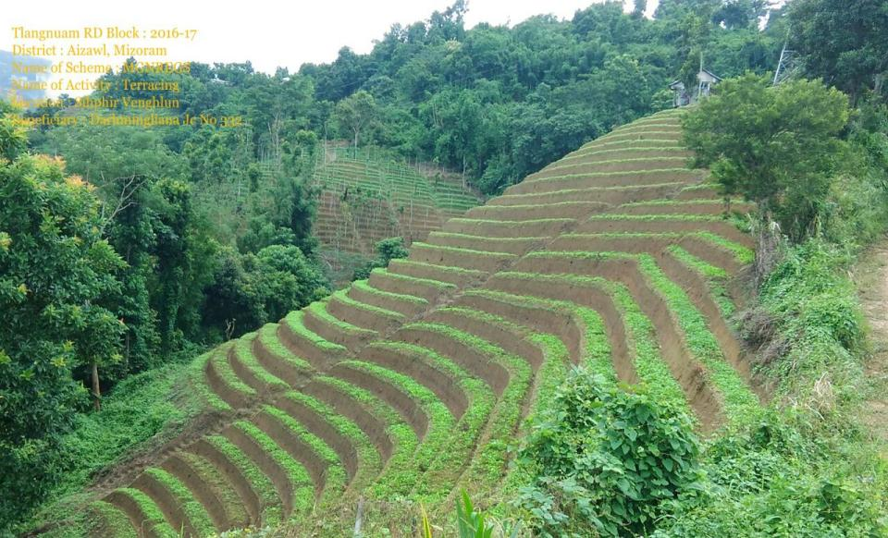

Slide 44
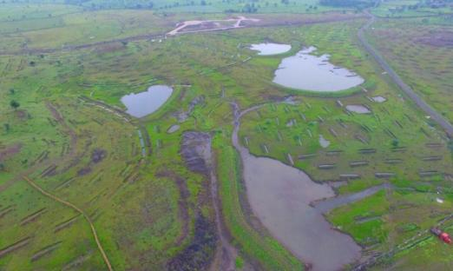
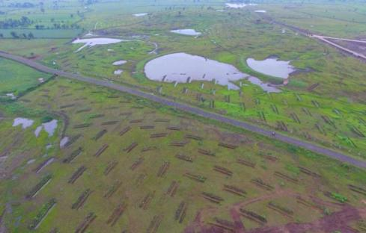
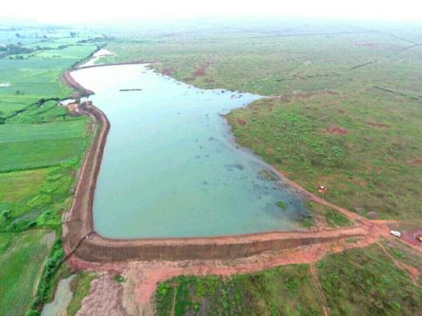
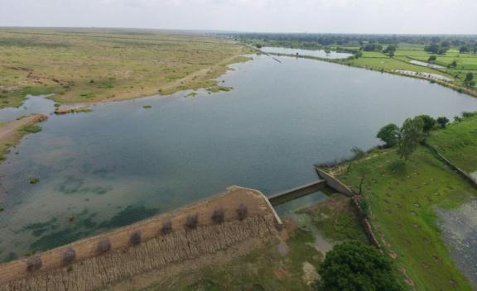
Mukhyamantri Jal Swavlamban Abhiyan, Rajasthan

Slide 45
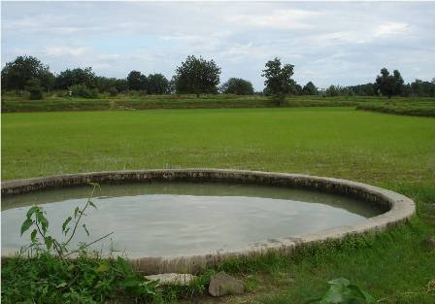
Well Created for irrigation, MP

Slide 46
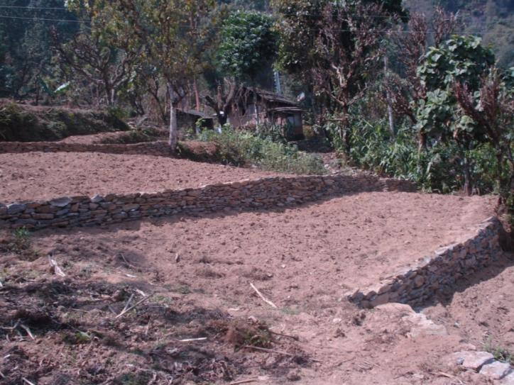
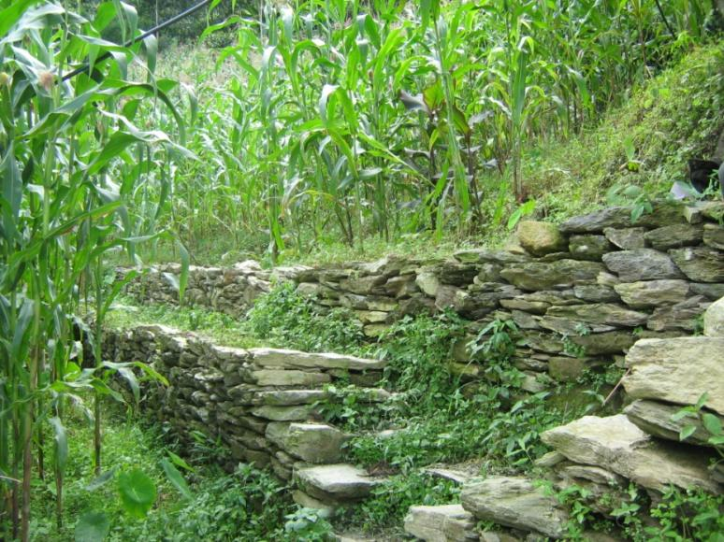
Converting barren sloping lands to productive terraced fields

Slide 47
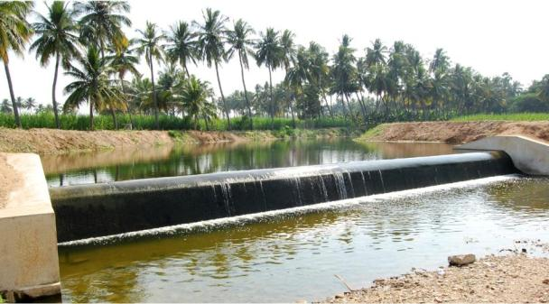
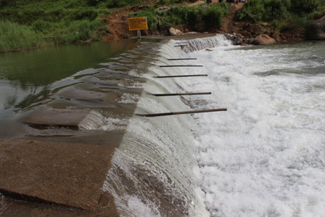
Check Dam, Kerala
Check Dam, Meghalaya

Slide 48
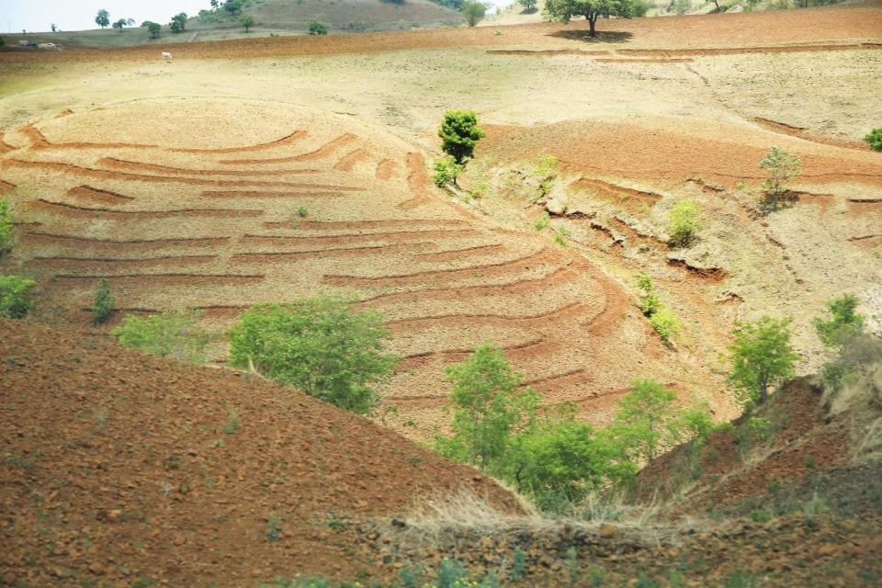
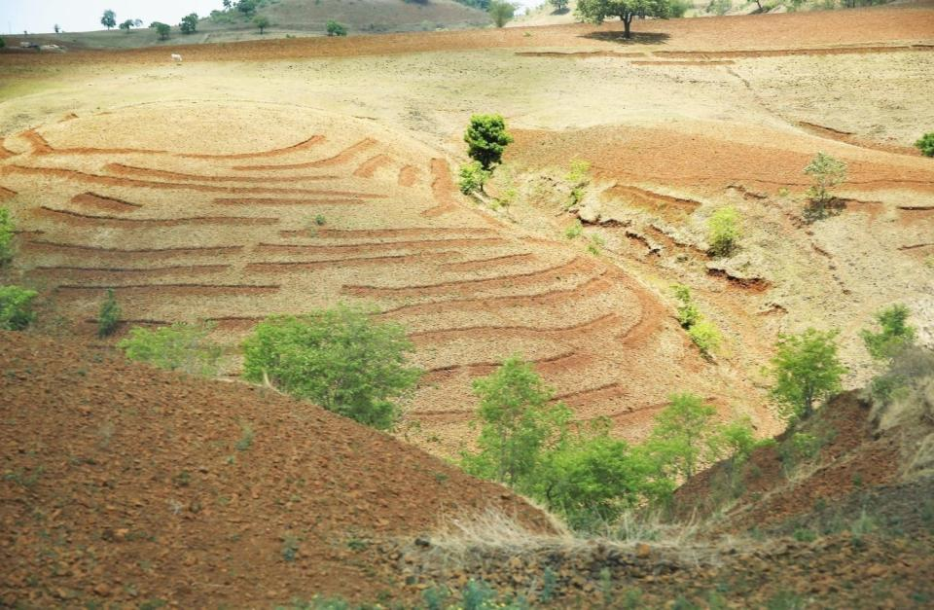
Contour Trenches; Village Doma; Block Chikhaldara; District Chandrapur, Maharashtra

Slide 49
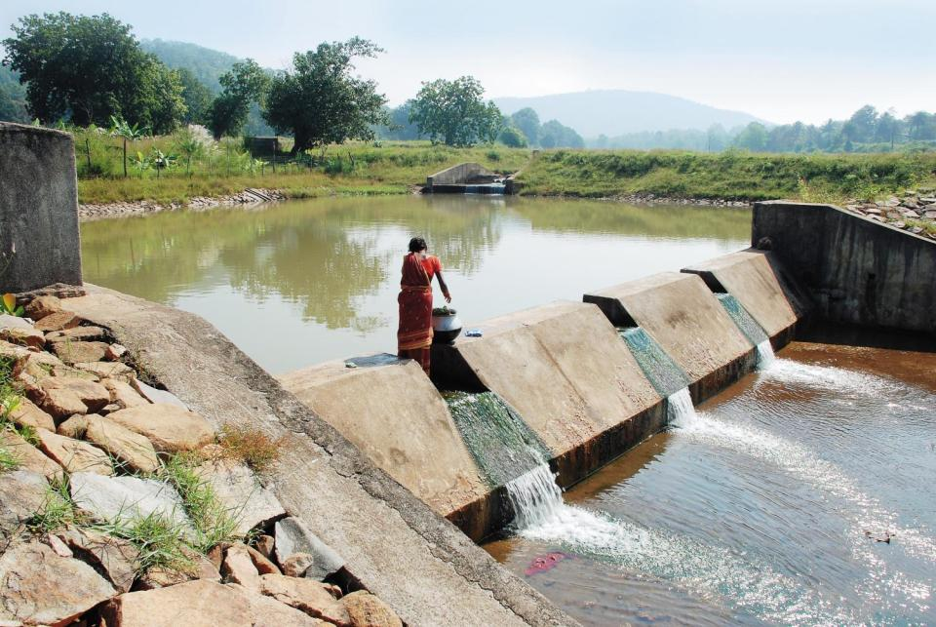
Check Dam; Village Dadpaju; Block Khajuri Pada; District Kandhamal, Odisha

Slide 50
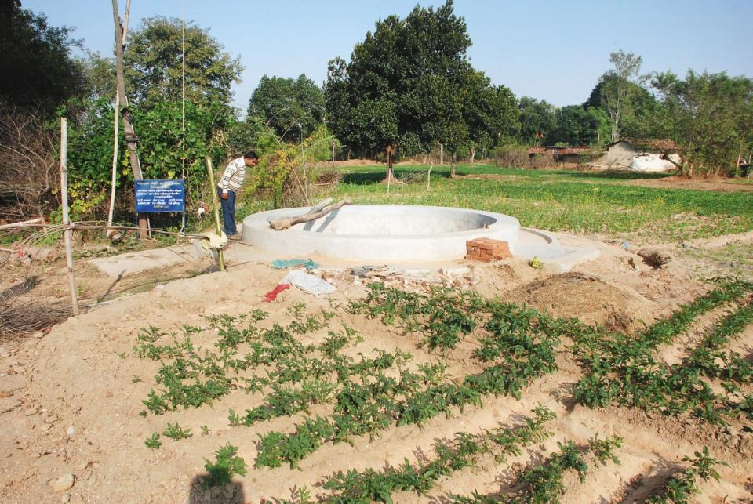
Irrigation Well; Village Naitand; Block Jainagar; District Kodarma, Jharkhand

Slide 51
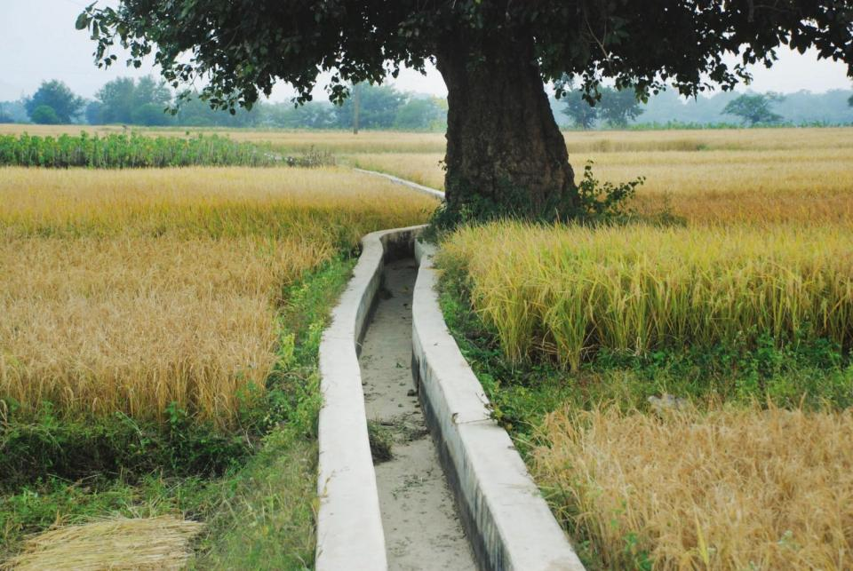
Irrigation Channel; Village Bardeva; Block Padma; District Hazaribagh, Jharkhand

Slide 52
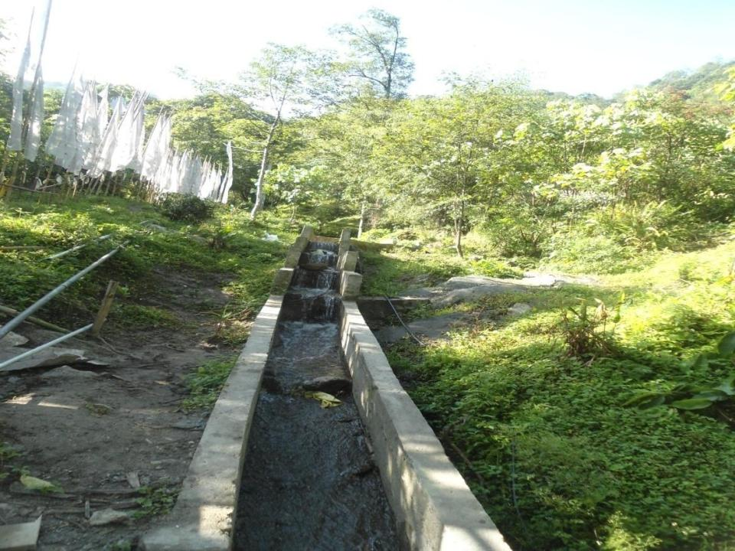

Slide 53
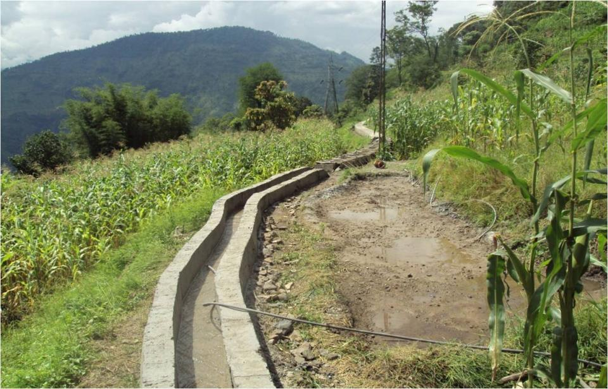
Expanding the network of minor irrigation channels

Slide 54
Converting barren sloping lands to productive terraced fields

Slide 55
Creation of Individual Assets (Category B)

Slide 56
Status of Category B work in FY 2016-17 so far
S.No. | State | Total works taken-up | Works taken-up Cat- B | % taken-up Cat- B
1 | KARNATAKA | 997798 | 673386 | 67%
2 | ODISHA | 566317 | 302973 | 53%
3 | WEST BENGAL | 1701213 | 904457 | 53%
4 | MADHYA PRADESH | 562771 | 267629 | 48%
5 | KERALA | 275092 | 121889 | 44%
6 | RAJASTHAN | 502496 | 220922 | 44%
7 | SIKKIM | 6289 | 2756 | 44%
8 | MIZORAM | 6930 | 2963 | 43%
9 | UTTAR PRADESH | 1283091 | 509997 | 40%
10 | MAHARASHTRA | 507325 | 190049 | 37%
11 | HARYANA | 19105 | 6094 | 32%
12 | BIHAR | 433156 | 119904 | 28%
13 | HIMACHAL PRADESH | 116569 | 26780 | 23%
14 | GUJARAT | 203854 | 41160 | 20%
15 | MEGHALAYA | 22746 | 4423 | 19%
16 | UTTARAKHAND | 159319 | 30964 | 19%
17 | ANDHRA PRADESH | 1947935 | 363102 | 19%
18 | JHARKHAND | 395074 | 72471 | 18%
19 | CHHATTISGARH | 445624 | 78544 | 18%
20 | ASSAM | 113216 | 19070 | 17%
21 | TAMIL NADU | 415313 | 66684 | 16%
22 | MANIPUR | 14145 | 2017 | 14%
23 | ARUNACHAL PRADESH | 8447 | 1174 | 14%
24 | TELANGANA | 2284811 | 171090 | 7%
25 | NAGALAND | 12301 | 771 | 6%
26 | TRIPURA | 134177 | 7282 | 5%
27 | GOA | 1295 | 39 | 3%
28 | JAMMU AND KASHMIR | 136081 | 571 | 0%
29 | PUNJAB | 38229 | 119 | 0%
30 | PUDUCHERRY | 650 | 1 | 0%
31 | ANDAMAN AND NICOBAR | 961 | 1 | 0%
32 | LAKSHADWEEP | 180 | 0 | 0%
 | Total | 13312510 | 4209282 | 32%

Slide 57
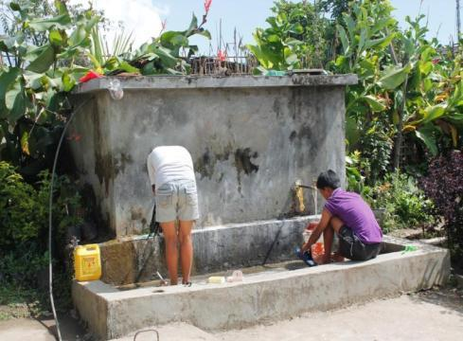
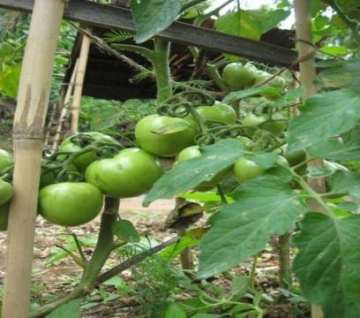
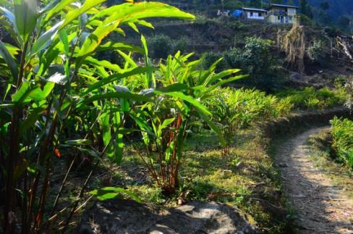
The water tanks covers the most drought prone blocks like Namthang, Sumbuk , Namchi , Temi, Thingling etc
Some village like Namthang, Chuba Pering, Sadam have now become the largest vegetable growers
A household earns an additional income of Rs. 20,000/- annum

Slide 58
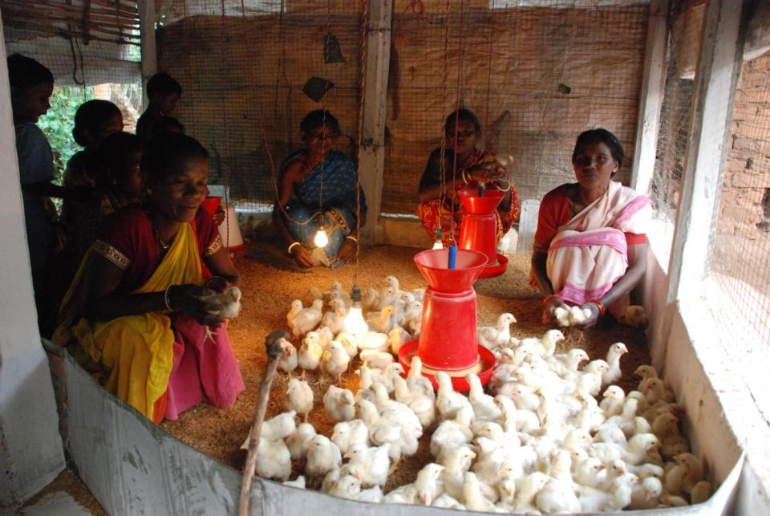
Poultry shelter; Village Ektali; Block Jashipur; District Mayurbhanj, Odisha

Slide 59
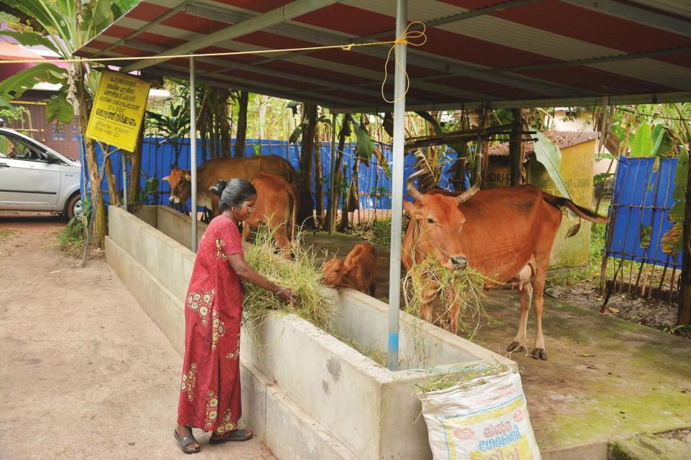
Cattle shelter; Village Mararikulam North; Block Kanjikuzhy; District Alappuzha, Kerala

Slide 60
Completion of incomplete works

Slide 61
Works Completion Rate
(Works started since inception till FY 2014-15)
S.No. | State | Works started | Works Completed | Incomplete Works | % Work Completed
1 | SIKKIM | 12246 | 12244 | 2 | 100%
2 | MIZORAM | 32769 | 32741 | 28 | 100%
3 | TRIPURA | 556187 | 552768 | 3419 | 99%
4 | TAMIL NADU | 972845 | 966524 | 6321 | 99%
5 | HARYANA | 81381 | 80447 | 934 | 99%
6 | KERALA | 759869 | 750731 | 9138 | 99%
7 | NAGALAND | 47097 | 46252 | 845 | 98%
8 | CHHATTISGARH | 698685 | 683191 | 15494 | 98%
9 | HIMACHAL PRADESH | 344164 | 335975 | 8189 | 98%
10 | JHARKHAND | 579720 | 564958 | 14762 | 97%
11 | PUNJAB | 64880 | 63037 | 1843 | 97%
12 | MEGHALAYA | 56164 | 54299 | 1865 | 97%
13 | MADHYA PRADESH | 2286140 | 2201053 | 85087 | 96%
14 | UTTARAKHAND | 209532 | 201638 | 7894 | 96%
15 | KARNATAKA | 1802861 | 1729509 | 73352 | 96%
16 | GUJARAT | 405304 | 388105 | 17199 | 96%
17 | PUDUCHERRY | 3189 | 3011 | 178 | 94%
18 | ANDHRA PRADESH | 3747662 | 3504376 | 243286 | 94%
19 | UTTAR PRADESH | 4037202 | 3746565 | 290637 | 93%
20 | WEST BENGAL | 1760451 | 1626492 | 133959 | 92%
21 | MANIPUR | 34709 | 32033 | 2676 | 92%
22 | JAMMU AND KASHMIR | 317425 | 290257 | 27168 | 91%
23 | RAJASTHAN | 1029597 | 935545 | 94052 | 91%
24 | TELANGANA | 3033296 | 2737855 | 295441 | 90%
25 | ODISHA | 612286 | 538500 | 73786 | 88%
26 | BIHAR | 681073 | 591859 | 89214 | 87%
27 | ASSAM | 176182 | 152119 | 24063 | 86%
28 | MAHARASHTRA | 734828 | 605118 | 129710 | 82%
29 | ARUNACHAL PRADESH | 7378 | 5313 | 2065 | 72%
30 | ANDAMAN AND NICOBAR | 2448 | 1706 | 742 | 70%
33 | GOA | 2818 | 1886 | 932 | 67%
34 | LAKSHADWEEP | 241 | 70 | 171 | 29%
 | Total | 25090629 | 23436177 | 1654452 | 93%

Slide 62
Works Completion rate
(Works started since inception till FY 2015-16)
S.No. | State | Works started | Works Completed | Incomplete Works | % Work Completed
1 | MIZORAM | 38989 | 38763 | 226 | 99%
2 | NAGALAND | 60366 | 58917 | 1449 | 98%
3 | TAMIL NADU | 1397013 | 1347926 | 49087 | 96%
4 | TRIPURA | 707411 | 678465 | 28946 | 96%
5 | KERALA | 981766 | 935473 | 46293 | 95%
6 | HIMACHAL PRADESH | 382448 | 357404 | 25044 | 93%
7 | PUDUCHERRY | 3329 | 3109 | 220 | 93%
8 | MEGHALAYA | 66142 | 61375 | 4767 | 93%
9 | MADHYA PRADESH | 2551467 | 2356408 | 195059 | 92%
10 | MANIPUR | 41404 | 38017 | 3387 | 92%
11 | HARYANA | 92827 | 84257 | 8570 | 91%
12 | ANDHRA PRADESH | 4289652 | 3887940 | 401712 | 91%
13 | JHARKHAND | 684644 | 620318 | 64326 | 91%
14 | GUJARAT | 480881 | 429733 | 51148 | 89%
15 | PUNJAB | 82599 | 72679 | 9920 | 88%
16 | UTTARAKHAND | 269586 | 227665 | 41921 | 84%
17 | UTTAR PRADESH | 4795354 | 4032309 | 763045 | 84%
18 | TELANGANA | 3541035 | 2958579 | 582456 | 84%
19 | KARNATAKA | 2346144 | 1954431 | 391713 | 83%
20 | CHHATTISGARH | 945043 | 773000 | 172043 | 82%
21 | JAMMU AND KASHMIR | 396953 | 320514 | 76439 | 81%
22 | RAJASTHAN | 1218484 | 970832 | 247652 | 80%
23 | SIKKIM | 16420 | 12976 | 3444 | 79%
24 | MAHARASHTRA | 932665 | 665518 | 267147 | 71%
25 | ODISHA | 942640 | 666559 | 276081 | 71%
26 | BIHAR | 879884 | 618449 | 261435 | 70%
27 | ASSAM | 229580 | 155812 | 73768 | 68%
28 | ANDAMAN AND NICOBAR | 2639 | 1775 | 864 | 67%
29 | WEST BENGAL | 2788188 | 1864019 | 924169 | 67%
30 | GOA | 3104 | 2061 | 1043 | 66%
33 | ARUNACHAL PRADESH | 9579 | 5971 | 3608 | 62%
34 | LAKSHADWEEP | 250 | 70 | 180 | 28%
 | Total | 31178486 | 26201324 | 4977162 | 84%

Slide 63
Works Completion rate
(Works started since inception till date)
S.No. | State | Works started | Works Completed | Incomplete Works | % Work Completed
1 | TRIPURA | 792057 | 710607 | 81450 | 90%
2 | MIZORAM | 44826 | 40208 | 4618 | 90%
3 | MADHYA PRADESH | 2691439 | 2388061 | 303378 | 89%
4 | TAMIL NADU | 1545266 | 1365940 | 179326 | 88%
5 | NAGALAND | 68266 | 59162 | 9104 | 87%
6 | KERALA | 1122591 | 962739 | 159852 | 86%
7 | HARYANA | 100965 | 85098 | 15867 | 84%
8 | HIMACHAL PRADESH | 431616 | 363253 | 68363 | 84%
9 | PUDUCHERRY | 3789 | 3109 | 680 | 82%
10 | ANDHRA PRADESH | 5275851 | 4311356 | 964495 | 82%
11 | UTTAR PRADESH | 5096359 | 4060831 | 1035528 | 80%
12 | MEGHALAYA | 78027 | 61611 | 16416 | 79%
13 | MANIPUR | 50064 | 39478 | 10586 | 79%
14 | JHARKHAND | 900441 | 696142 | 204299 | 77%
15 | GUJARAT | 603176 | 455256 | 147920 | 75%
16 | JAMMU AND KASHMIR | 431171 | 321392 | 109779 | 75%
17 | TELANGANA | 4364534 | 3212862 | 1151672 | 74%
18 | CHHATTISGARH | 1074770 | 783493 | 291277 | 73%
19 | PUNJAB | 102097 | 74297 | 27800 | 73%
20 | RAJASTHAN | 1345483 | 974371 | 371112 | 72%
21 | KARNATAKA | 2818037 | 2000366 | 817671 | 71%
22 | SIKKIM | 18576 | 13032 | 5544 | 70%
23 | ODISHA | 1041878 | 676382 | 365496 | 65%
24 | ANDAMAN AND NICOBAR | 2788 | 1800 | 988 | 65%
25 | UTTARAKHAND | 366560 | 233579 | 132981 | 64%
26 | MAHARASHTRA | 1065564 | 677550 | 388014 | 64%
27 | GOA | 3317 | 2073 | 1244 | 62%
28 | BIHAR | 1006595 | 620244 | 386351 | 62%
29 | ASSAM | 257065 | 155881 | 101184 | 61%
30 | WEST BENGAL | 3270947 | 1869936 | 1401011 | 57%
31 | ARUNACHAL PRADESH | 14150 | 6997 | 7153 | 49%
32 | LAKSHADWEEP | 250 | 70 | 180 | 28%
 | Total | 35988515 | 27227176 | 8761339 | 76%

Slide 64
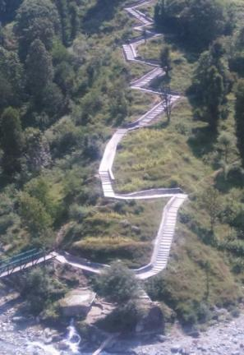
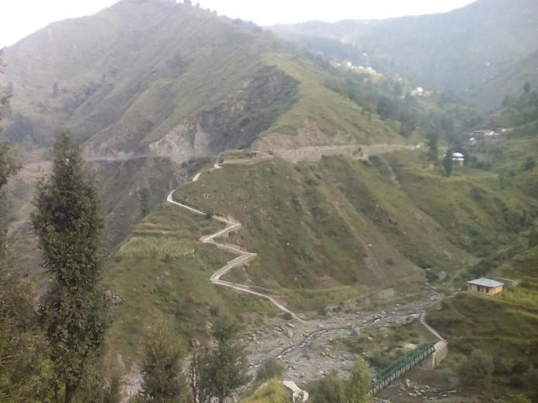
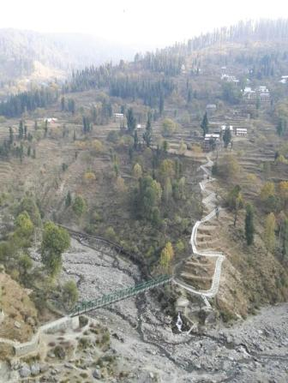
Path & Footbridge from PWD Road to Gujrara Paristhan Block Ukheral District Ramban under Convergence with MGNREGA

Slide 65

Renovation of Doling Lake; Village Dolling; Block Ravangla; District South Sikkim, Sikkim

Slide 66
Irrigation Well; Village Naitand; Block Jainagar; District Kodarma, Jharkhand

Slide 67
Irrigation Channel; Village Bardeva; Block Padma; District Hazaribagh, Jharkhand

Slide 68
Timely payment of wages/ Delay compensation

Slide 69
delay payment in FY 2016-17
(% of transactions with delay)
As per MIS no wage payment has been done in A & N and Lakshdweep in current FY

Slide 70
Direct Benefit Transfer, e-FMS Unversalization
&
Capacity Building
(Digital Payment)

Slide 71
AADHAAR SEEDING & CONVERSION
Active worker (10.86 Cr)
ABP Conversion (3.91 Cr)

Slide 72
RECENT DEVELOPMENT : ABP CONVERSION
Secretary, RD has written to Chief Secretaries to expedite ABP conversion (Dt. 9 Jan 17).
Joint Secretary, MGNREGA & DFS (Dt. 9 Jan 17)
  Meeting be convened by Principal Secretary/ Secretary, RD with SLBC Conveners and State Chiefs of all banks.
  Reconcile figures of consent forms handed over to banks and other related issues.
  MoRD & DFS reviewing the ABP conversion with Banks (Every Wednesday).

Slide 73
AADHAAR SEEDING & CONVERSION
# | States Name | %age Aadhaar | Active workers (In Lakh) | Aadhaar Seeded (In Lakh) | %age seeding | ABP enabled (In Lakh) | %age ABP | PO Pendency
1 | A & N | 100% | 0.26 | 0.25 | 50% | 0.00 | 0% | 0
2 | AP | 108% | 78.00 | 77.56 | 99% | 67.89 | 87% | 0
3 | Ar Pd | 80% | 2.26 | 0.84 | 37% | 0.00 | 0% | 35601
4 | ASSAM | 7% | 34.19 | 0.00 | 0% | 0.00 | 0% | 0
5 | BIHAR | 94% | 48.94 | 17.84 | 36% | 2.12 | 4% | 149810
6 | CHHATISGARH | 106% | 55.51 | 51.41 | 93% | 13.12 | 24% | 49581
7 | GOA | 104% | 0.12 | 0.10 | 90% | 0.03 | 27% | 1559
8 | GUJARAT | 99% | 18.19 | 16.95 | 93% | 3.53 | 19% | 46115
9 | HARYANA | 109% | 6.90 | 6.89 | 100% | 4.77 | 69% | 1234
10 | HP | 109% | 9.90 | 9.68 | 98% | 6.82 | 69% | 5291
11 | J & K | 85% | 14.19 | 4.04 | 28% | 0.02 | 0% | 158383
12 | JHARKHAND | 107% | 27.03 | 26.42 | 98% | 16.99 | 63% | 24124
13 | KARNATAKA | 99% | 62.74 | 55.35 | 88% | 22.31 | 36% | 39770
14 | KERALA | 107% | 22.80 | 22.42 | 98% | 17.22 | 76% | 6810
15 | LAKSHADWEEP | 110% | 0.011 | 0.010 | 96% | 0.00 | 14% | 0
16 | MP | 102% | 77.28 | 70.00 | 91% | 17.45 | 23% | 165427
 | NATIONAL | 99.5% | 1,086.03 | 866.56 | 80% | 390.51 | 36% | 18,56,208

Slide 74
AADHAAR SEEDING & CONVERSION
# | States Name | %age Aadhaar | Active workers (In Lakh) | Aadhaar Seeded (In Lakh) | %age seeding | ABP enabled (In Lakh) | %age ABP | PO Pendency
1 | 2 | 4 | 5 | 6 | 7 | 8 | 9 | 10
17 | MAHARASHTRA | 102% | 43.39 | 41.43 | 95% | 11.53 | 27% | 32573
18 | MANIPUR | 80% | 5.83 | 2.28 | 39% | 0.05 | 1% | 117410
19 | MEGHALAYA | 11% | 6.86 | 0.00 | 0% | 0.00 | 0% | 185
20 | MIZORAM | 60% | 2.56 | 0.55 | 22% | 0.15 | 6% | 269
21 | NAGALAND | 69% | 5.71 | 1.33 | 23% | 0.01 | 0% | 69869
22 | ODISHA | 98% | 49.55 | 33.24 | 67% | 7.10 | 14% | 255419
23 | PUDUCHERRY | 104% | 0.529 | 0.525 | 99% | 0.44 | 84% | 97
24 | PUNJAB | 110% | 9.5 | 9.2 | 97% | 6.66 | 70% | 8957
25 | RAJASTHAN | 108% | 90.3 | 75.7 | 84% | 32.96 | 36% | 187818
26 | SIKKIM | 105% | 0.9 | 0.9 | 100% | 0.58 | 62% | 1798
27 | TAMIL NADU | 98% | 89.0 | 84.0 | 94% | 51.67 | 58% | 37225
28 | TELANGANA | 108% | 56.2 | 53.7 | 96% | 50.47 | 90% | 0
29 | TRIPURA | 104% | 10.7 | 10.5 | 99% | 6.55 | 61% | 50951
30 | UP | 104% | 103.3 | 86.2 | 83% | 10.41 | 10% | 184912
31 | UTTARAKHAND | 106% | 9.1 | 8.8 | 98% | 3.46 | 38% | 14660
32 | WEST BENGAL | 97% | 144.3 | 98.3 | 68% | 36.20 | 25% | 210360
 | NATIONAL | 99.5% | 1,086.03 | 866.56 | 80% | 390.51 | 36% | 18,56,208

Slide 75
e-FMS UNIVERSALIZATION: COVERAGE OF GPs
 | WAGES | MATERIAL | ADMIN
eFMS Location (Sep-16) | 92% | 71% | 58%
eFMS Location (Dec-16) | 92% | 88% | 74%
Upscale e-FMS from 1st Apr, 2017.
Share the strategy in the meeting on 23rd Jan, 2017

Slide 76
e-FMS UNIVERSALIZATION: COVERAGE OF GPs
# | States | Total GPs | WAGES | MATERIAL | ADMINISTRATIVE
 |  |  | %AGE | %AGE | %AGE
1 | 2 | 3 | 5 | 7 | 9
1 | A & NICOBAR | 78 | 0% | 0% | 0%
2 | AP | 13084 | 99% | 99% | 99%
3 | ARU PRADESH | 1826 | 0% | 0% | 0%
4 | ASSAM | 2644 | 100% | 100% | 100%
5 | BIHAR | 8529 | 100% | 100% | 100%
6 | CHHATTISGARH | 10971 | 83% | 100% | 96%
7 | GOA | 190 | 0% | 0% | 0%
8 | GUJARAT | 14348 | 99% | 99% | 99%
9 | HARYANA | 6287 | 100% | 100% | 100%
10 | HP | 3251 | 96% | 96% | 100%
11 | J&K | 4206 | 0% | 0% | 0%
12 | JHARKHAND | 4414 | 100% | 100% | 100%
13 | KARNATAKA | 6022 | 100% | 100% | 100%
14 | KERALA | 941 | 100% | 100% | 100%
15 | LAKSHADWEEP | 10 | 0% | 0% | 0%
16 | MAHARASHTRA | 28719 | 99% | 99% | 99%
 | Total | 262440 | 92% | 88% | 74%

Slide 77
e-FMS UNIVERSALIZATION
# | States | Total GPs | WAGES | MATERIAL | ADMINISTRATIVE
 |  |  | %AGE | %AGE | %AGE
1 | 2 | 3 | 5 | 7 | 9
17 | MANIPUR | 3151 | 0% | 0% | 0%
18 | MEGHALAYA | 6259 | 0% | 0.2% | 0%
19 | MIZORAM | 859 | 8% | 0% | 0%
20 | MP | 22828 | 100% | 100% | 0%
21 | NAGALAND | 1207 | 0% | 0% | 0%
22 | ODISHA | 6211 | 100% | 100% | 100%
23 | PUDUCHERRY | 10 | 100% | 100% | 100%
24 | PUNJAB | 13104 | 100% | 100% | 0%
25 | RAJASTHAN | 9894 | 100% | 100% | 100%
26 | SIKKIM | 176 | 34% | 0% | 0%
27 | TAMIL NADU | 12524 | 100% | 0.4% | 0%
28 | TELANGANA | 8831 | 99% | 99% | 99%
29 | TRIPURA | 1178 | 100% | 96% | 95%
30 | UTTAR PRADESH | 59149 | 100% | 100% | 100%
31 | UTTARAKHAND | 7985 | 100% | 99% | 99%
32 | WEST BENGAL | 3347 | 100% | 100% | 100%
 | Total | 262440 | 92% | 88% | 74%

Slide 78
262440

Slide 79


Digital Payment Training
Haryana
Virtual class room session on cashless payment in Kerala

Slide 80


Digital Payment Training
Telangana
Mizoram

Slide 81
Status of job card verification

Slide 82
Status of Job-card verification/ Updation
S No. | States | Job Cards Issued (in lakh) |  | Job Cards Verified (in lakh) |  | % of Job Cards Verified
 |  | All | Active | All | Active | All | Active
1 | TELANGANA | 5815913 | 2783086 | 5778752 | 2781496 | 99.4 | 99.9
2 | SIKKIM | 78080 | 71912 | 77811 | 71797 | 99.7 | 99.8
3 | MIZORAM | 188033 | 186937 | 186911 | 186098 | 99.4 | 99.6
4 | TRIPURA | 604660 | 595664 | 583758 | 576756 | 96.5 | 96.8
5 | KERALA | 3187304 | 1985048 | 2956191 | 1907632 | 92.8 | 96.1
6 | TAMIL NADU | 8019259 | 6978890 | 7403550 | 6680073 | 92.3 | 95.7
7 | CHHATTISGARH | 3529422 | 2886139 | 3284628 | 2717645 | 93.1 | 94.2
8 | ANDHRA PRADESH | 7770672 | 3764925 | 5892270 | 3540413 | 75.8 | 94.0
9 | HIMACHAL PRADESH | 1175615 | 724170 | 1063275 | 670877 | 90.4 | 92.6
10 | MEGHALAYA | 500130 | 453980 | 443053 | 416986 | 88.6 | 91.9
11 | MADHYA PRADESH | 5979699 | 3952457 | 5002902 | 3515236 | 83.7 | 88.9
12 | UTTARAKHAND | 1048252 | 704115 | 807743 | 590756 | 77.1 | 83.9
13 | KARNATAKA | 5314332 | 2637703 | 4176410 | 2206529 | 78.6 | 83.7
14 | RAJASTHAN | 9570498 | 5924958 | 7283818 | 4923487 | 76.1 | 83.1
15 | ASSAM | 4383428 | 2384236 | 3083214 | 1912787 | 70.3 | 80.2
16 | ARUNACHAL PRADESH | 210381 | 202829 | 158658 | 153974 | 75.4 | 75.9
17 | JAMMU AND KASHMIR | 1170584 | 914927 | 798511 | 664894 | 68.2 | 72.7
18 | WEST BENGAL | 12072643 | 8444943 | 7175827 | 5920393 | 59.4 | 70.1
19 | GUJARAT | 3392249 | 1063881 | 1343799 | 617514 | 39.6 | 58.0
20 | HARYANA | 828686 | 465601 | 409812 | 269204 | 49.5 | 57.8
21 | PUNJAB | 1241490 | 743160 | 650548 | 394979 | 52.4 | 53.2
22 | UTTAR PRADESH | 15325234 | 8232936 | 5335167 | 3190786 | 34.8 | 38.8
23 | LAKSHADWEEP | 8081 | 1161 | 2452 | 440 | 30.3 | 37.9
24 | MAHARASHTRA | 7924076 | 2313831 | 1850695 | 866153 | 23.4 | 37.4
25 | JHARKHAND | 3835462 | 1979589 | 1124420 | 698297 | 29.3 | 35.3
26 | ODISHA | 6583443 | 3005113 | 1444284 | 1032596 | 21.9 | 34.4
27 | ANDAMAN AND NICOBAR | 34781 | 19580 | 7684 | 5536 | 22.1 | 28.3
28 | PUDUCHERRY | 69531 | 47020 | 14171 | 11907 | 20.4 | 25.3
29 | MANIPUR | 538862 | 518727 | 120377 | 118924 | 22.3 | 22.9
30 | NAGALAND | 426184 | 424481 | 74136 | 74132 | 17.4 | 17.5
31 | BIHAR | 13694731 | 3869649 | 432354 | 336521 | 3.2 | 8.7
32 | GOA | 32277 | 10966 | 276 | 275 | 0.9 | 2.5
 | Total | 124557541 | 68292614 | 68967457 | 47055093 | 55.4 | 68.9

Slide 83


Job-card verification
Sivasagar, Assam

Slide 84
Adoption of
7 Registers

Slide 85

Adoption of 7 Registers
Maintenance of 7 Registers in Dhamtari, Chhattisgarh
As a good governance initiative the Registers to be maintained under MGNREGS at the GP level has been reduced to 7 from an average of 22 Registers, in consultation and agreement with the States. States have been requested to maintain Register in new format by 31st December, 2016.

Slide 86
List of 7 Registers
SN | Registers
1 | Register I- Job Card Application, Registration, Issue and Employment summary Register.
2 | Register II- Gram Sabha Meetings, minutes, Shelf of Works and Social Audit Register
3 | Register III- Demand, Allocation of Works to Payments of Wages Register
4 | Register IV- Works Register
5 | Register V – Assets Register
6 | Register VI- Complaint Register
7 | Register VII-Material Register

Slide 87
Status of Adoption of 7 Registers
S No. | States | Total GPs | GPs where Seven Registers maintained | Percentage
1 | CHHATTISGARH | 10971 | 10971 | 100%
2 | MIZORAM | 859 | 859 | 100%
3 | ODISHA | 6211 | 6211 | 100%
4 | SIKKIM | 176 | 176 | 100%
5 | TAMIL NADU | 12524 | 12524 | 100%
6 | KARNATAKA | 6022 | 6009 | 100%
7 | KERALA | 941 | 898 | 95%
8 | GUJARAT | 14348 | 13473 | 94%
9 | JAMMU AND KASHMIR | 4206 | 3905 | 93%
10 | NAGALAND | 1207 | 1067 | 88%
11 | JHARKHAND | 4414 | 3864 | 88%
12 | HARYANA | 6287 | 5444 | 87%
13 | TRIPURA | 1178 | 983 | 83%
14 | TELANGANA | 8831 | 6993 | 79%
15 | PUNJAB | 13104 | 10221 | 78%
16 | RAJASTHAN | 9894 | 7531 | 76%
17 | UTTARAKHAND | 7985 | 5700 | 71%
18 | LAKSHADWEEP | 10 | 7 | 70%
19 | MADHYA PRADESH | 22828 | 14417 | 63%
20 | ARUNACHAL PRADESH | 1827 | 1022 | 56%
21 | WEST BENGAL | 3347 | 1835 | 55%
22 | HIMACHAL PRADESH | 3251 | 1671 | 51%
23 | ASSAM | 2644 | 1224 | 46%
24 | UTTAR PRADESH | 59150 | 26228 | 44%
25 | BIHAR | 8529 | 1293 | 15%
26 | GOA | 190 | 9 | 5%
27 | MEGHALAYA | 6259 | 38 | 1%
28 | MAHARASHTRA | 28719 | 65 | 0%
29 | MANIPUR | 3151 | 1 | 0%
30 | ANDHRA PRADESH | 13084 | 0 | 0%
31 | ANDAMAN AND NICOBAR | 78 | 0 | 0%
32 | PUDUCHERRY | 12 | 0 | 0%
 | Total | 262440 | 144639 | 55%

Slide 88
Social Audit

Slide 89
Status of Social Audit
Status of Resource Persons in Social Audit
S.No. | States | Target for 2016-17 [ Target (hired) ]
 |  | SRPs | DRPs | BRPs | Total
1 | Andhra Pradesh | 7 (4) | 73 (58) | 618 (569) | 698 (631)
2 | Arunachal Pradesh | 2 (0) | 20 (0) | 50 (0) | 72 (0)
3 | Assam | 5 (0) | 27 (0) | 219 (0) | 251 (0)
4 | Bihar | 5 (0) | 62 (0) | 0 (0) | 67 (0)
5 | Chhattisgarh | 6 (6) | 88 (88) | 371 (371) | 465 (465)
6 | Gujarat | 5 (2) | 16 (11) | 0 (0) | 21 (13)
7 | Haryana | 4 (0) | 4 (0) | 0 (0) | 8 (0)
8 | Himachal Pradesh | 2 (1) | 16 (0) | 0 (0) | 18 (1)
9 | Jammu & Kashmir | 4 (0) | 21 (21) | 0 (0) | 25 (21)
10 | Jharkhand | 4 (0) | 24 (0) | 300 (0) | 328 (0)
11 | Karnataka | 6 (3) | 32 (24) | 176 (172) | 214 (199)
12 | Kerala | 3 (0) | 37 (0) | 300 (0) | 340 (0)
13 | Madhya Pradesh | 4 (0) | 51 (0) | 0 (0) | 55 (0)
14 | Maharashtra | 6 (3) | 38 (0) | 0 (0) | 44 (3)
15 | Manipur | 2 (0) | 9 (0) | 58 (0) | 69 (0)
16 | Meghalaya | 4 (4) | 13 (13) | 78 (78) | 95 (95)
17 | Mizoram | 1 (1) | 5 (5) | 60 (60) | 66 (66)
18 | Nagaland | 2 (2) | 24 (24) | 0 (0) | 26 (26)
19 | Odisha | 6 (6) | 32 (32) | 314 (0) | 352 (38)
20 | Punjab | 4 (3) | 11 (0) | 0 (0) | 15 (3)
21 | Rajasthan | 6 (0) | 99 (0) | 0 (0) | 105 (0)
22 | Sikkim | 5 (5) | 22 (22) | 18 (18) | 45 (45)
23 | Tamil Nadu | 6 (3) | 31 (31) | 770 (709) | 807 (743)
24 | Telangana | 7 (7) | 52 (42) | 442 (363) | 501 (412)
25 | Tripura | 2 (1) | 36 (21) | 116 (0) | 154 (22)
26 | Uttar Pradesh | 15 (0) | 103 (72) | 821 (632) | 939 (704)
27 | Uttrakhand | 2 (0) | 7 (0) | 0 (0) | 9 (0)
28 | West Bengal | 4 (4) | 128 (124) | 0 (0) | 132 (128)
 | Total | 129 (55) | 1081 (588) | 4711 (2972) | 5921 (3615)

Slide 90
Status of Social Audit
S.No. | States | Number of Resource Persons trained as on 09th January, 2017
 |  | SRPs | DRPs | BRPs | Total
1 | Andhra Pradesh | 0 (0%) | 8 (11%) | 72 (12%) | 80 (11%)
2 | Chhattisgarh | 0 (0%) | 1 (1%) | 39 (11%) | 40 (9%)
3 | Jharkhand | (0%) | 0 (0%) | 49 (16%) | 49 (15%)
4 | Karnataka | 1 (17%) | 4 (13%) | 73 (41%) | 78 (36%)
5 | Meghalaya | 1 (25%) | 5 (38%) | 29 (37%) | 35 (37%)
6 | Mizoram | 1 (100%) | 27 (540%) | 0 (0%) | 28 (42%)
7 | Nagaland | 2 (100%) | 24 (100%) | 3 ( ** ) | 29 (112%)
8 | Sikkim | 4 (80%) | 19 (86%) | 17 (94%) | 40 (89%)
9 | Tamil Nadu | 9 (150%) | 28 (90%) | 324 (42%) | 361 (45%)
10 | Telangana | 0 (0%) | 4 (8%) | 76 (17%) | 80 (16%)
11 | Tripura | 1 (50%) | 20 (56%) | 0 (0%) | 21 (14%)
12 | Uttar Pradesh | 0 (0%) | 13 (13%) | 161 (20%) | 174 (19%)
13 | West Bengal | 1 (25%) | 0 (0%) | 35 ( ** ) | 36 (27%)
 | Total | 20 (16%) | 140 (13%) | 717 (15%) | 877 (15%)
The States that have yet to begin the training are :
ARUNACHAL PRADESH, ASSAM, BIHAR, GUJARAT , HARYANA, HIMACHAL PRADESH , JAMMU & KASHMIR, KERALA, MADHYA PRADESH , MAHARASHTRA, MANIPUR, ODISHA, PANJAB, RAJASTHAN AND UTTARAKHAND

Slide 91
RECENT DEVELOPMENTS
The Ministry has introduced Auditing Standards that are based on recommendations of the Task Force to strengthen the process of social audits and ensure the compliance of Audit of Scheme Rules, 2011. These standards will reinforce the government’s efforts to institutionalise social audits in the states. An office Memorandum, L-11033/40/2016-RE-VII dated 19th December 2016, with the Auditing Standards has been circulated among all the States.
The Secretary, RD has also written to all state Chief Secretaries to lay emphasis on involvement of community cadre of SHG women in the process of Social Audits (DO-L-11033/40/2016-RE7 dated 2nd January, 2017).
Audit paras of C&AG Report 8 on Mahatma Gandhi NREGA Audit of Scheme Rules 2011 have been circulated to the states vide communication F.No H-11013/4/2016- MGNREGA (VIII) dated 12th January 2017. Responses are to be furnished by 10th February 2017

Slide 92


Social Audit Unit: training of District Resource Persons in Mizoram
Training under social audit capacity building plan started from today in Sikkim

Slide 93
Barefoot Technicians (BFTs)

Slide 94
Status of Barefoot Technicians (BFTs)
S No | States | BFT Target for 2016-17 | BFTs under Training | BFT Trained till Date | BFTs certified | BFTs Deployed
1 | Andhra Pradesh | 660 | 102 | 70 | 0 | 0
2 | Arunachal Pradesh | 90 | 55 | 30 | 0 | 0
3 | Bihar | 660 | 224 | 0 | 0 | 0
4 | Chhattisgarh | 360 | 41 | 125 | 77 | 77
5 | Gujrat | 240 | 43 | 60 | 0 | 0
6 | Haryana | 60 | 60 | 0 | 0 | 0
7 | Jharkhand | 660 | 271 | 148 | 73 | 26
8 | Karnataka | 720 | 391 | 121 | 0 | 0
9 | Kerala | 150 | 0 | 93 | 57 | 32
10 | Madhya Pradesh | 1020 | 527 | 385 | 0 | 0
11 | Manipur | 90 | 35 | 0 | 0 | 0
12 | Meghalaya | 90 | 57 | 30 | 0 | 0
13 | Punjab | 90 | 60 | 0 | 0 | 0
14 | Rajasthan | 623 | 106 | 412 | 263 | 7
15 | Uttarakhand | 660 | 234 | 270 | 0 | 0
16 | West Bengal | 654 | 136 | 177 | 0 | 0
 | TOTAL | 6827 | 2342 | 1921 | 470 | 142

Slide 95


Training of BFTs
In Samalkot, AP

Slide 96




Slide 97
Information Education and Communication

Slide 98


Information display board
Jharkhand
Chhattisgarh
According to Para 25-(a) of Schedule-I , Proactive disclosure of basic information to all common people and stake holder using ‘Janata Information System’ is mandatory.
It includes:
Display at each worksite
Display on prominent walls or Public board
Display through boards at the Gram Panchayat Office
Wall writing

Slide 99


Wall Writing
Andhra Pradesh
Chhattisgarh

Slide 100
Status on DTRT and BTRT training on Samarthya Manual

Slide 101
Status on DTRT and BTRT training on Samarthya Manual
Sr. No. | States / UTs | Proposed number to be trained |  | Trained so far |  | Left over to be trained |  | Remarks
 |  | DTRT Members | BTRT Member | DTRT Members | BTRT Members | DTRT members | BTRT members
1 | MAHARASHTRA | 272 | 2808 | 272 | 2808 | COMPLETED | COMPLETED | Completion Report received
2 | MIZORAM | 23 | 88 | 22 | 60 | COMPLETED | COMPLETED | Completion Report received
3 | SIKKIM | 2 | 31 | 2 | 31 | COMPLETED | COMPLETED | Completion Report received
4 | TAMIL NADU | 1002 | 2002 | 1002 | 2002 | COMPLETED | COMPLETED | Completion Report received
5 | KERALA | 56 | 1851 | 54 | 1851 | COMPLETED | COMPLETED | Completion Report awaited
6 | PONDICHERRY | 12 | 30 | 12 | 30 | COMPLETED | COMPLETED | Completion Report awaited
7 | RAJASTHAN | 99 | 2600 | 99 | 2600 | COMPLETED | COMPLETED | Completion Report awaited
8 | TELANGANA | 94 | 1953 | 94 | 1953 | COMPLETED | COMPLETED | Partial Report received, Completion Report awaited
9 | TRIPURA | 56 | 580 | 56 | 580 | COMPLETED | COMPLETED | Completion Report awaited
10 | ANDAMAN AND NICOBAR | 17 | 84 | 44 | 21 | 6 | 63

Slide 102
Status on DTRT and BTRT training on Samarthya Manual
Sr. No. | States / UTs | Proposed number to be trained |  | Trained so far |  | Left over to be trained |  | Remarks
 |  | DTRT Members | BTRT Member | DTRT Members | BTRT Members | DTRT members | BTRT members
11 | ANDHRA PRADESH | 130 | 2437 | 126 | 1783 | COMPLETED | 654
12 | ARUNACHAL PRADESH | 40 | 335 | 23 | 180 | 17 | 155
13 | ASSAM | 135 | 876 | 135 | 798 | COMPLETED | 78
14 | BIHAR | 61 | 1635 | 11 | NIL | 50 | 1642
15 | CHHATTISGARH | 464 | 2008 | 435 | 1964 | 29 | 44 | Partial Report received
16 | HARYANA | 49 | 152 | 5 | 0 | 47 | 149
17 | JAMMU AND KASHMIR | 805 | 2507 | 65 | 95 | 740 | 2412
18 | JHARKHAND | 121 | 457 | 89 | 368 | 32 | 32
19 | KARNATAKA | 120 | 3750 | 150 | 1718 | NIL | 2032
20 | LAKSHADWEEP | 6 | 18 | 6 | 3 | COMPLETED | 15 | Partial report received

Slide 103
Status on DTRT and BTRT training on Samarthya Manual
Sr. No. | States / UTs | Proposed number to be trained |  | Trained so far |  | Left over to be trained
 |  | DTRT Members | BTRT Member | DTRT Members | BTRT Members | DTRT members | BTRT members
21 | MANIPUR | 54 | 246 | 54 | NIL | 54 | 246
22 | MEGHALAYA | 82 | 470 | 89 | 110 | COMPLETED | 360
23 | NAGALAND | 33 | 222 | 13 | 52 | 20 | 170
24 | ODISHA | 320 | 4728 | 320 | 0 | COMPLETED | 4728
25 | UTTAR PRADESH | 2250 | 4926 | 750 | 1642 | 1500 | 3284
26 | WEST BENGAL | 160 | 8376 | 160 | 1330 | COMPLETED | 7046
27 | GOA | NA | NA | NA | NA | NA | NA
28 | GUJARAT | 132 | 976 | NIL | NIL | 132 | 976
29 | HIMACHAL PRADESH | 144 | 385 | NIL | NIL | 144 | 385
30 | MP | 1020 | 7825 | NIL | NIL | 1020 | 7825
31 | PUNJAB | 264 | 2190 | NIL | NIL | 264 | 2190
32 | UTTARAKHAND | 130 | 950 | NIL | NIL | 130 | 950
 | Total | 8153 | 57496 | 4088 | 20026 | 4065 | 37470

Slide 104
Summary of DTRT and BTRT training on Samarthya Manual
TITLE | STATES | ACTION REQUESTED
Training completed and completion report received: | 4 (Maharashtra, Mizoram, Sikkim and Tamil Nadu) | No Action
Training completed but completion report is awaited: | 5 (Kerala, Pondicherry, Rajasthan, Telangana and Tripura) | Detailed completion report awaited (List of Trainees, Photos etc.).
States / UTs started but yet to complete training: | 17 (A & N, Ar Pd, Assam, Bihar, Chhattisgarh, Haryana, J & K, Jharkhand, Karnataka, Lakshadweep, Manipur, Meghalaya, Nagaland, Odisha, Telangana, UP, WB) | Share the calendar for left over training and initiate the training.
States yet to start training: | 6 (Goa, Gujarat, Himachal Pradesh, Madhya Pradesh, Punjab and Uttarakhand) | Share training calendar and initiate the training.

Slide 105
Status of Project LIFE

Slide 106
LIFE: Status of skilling for wages
Sl. No. | States | Fund Released Rs. In cr (Skilling For Wages ) | Skilling For Wages
 |  |  | Revised Target | Training Completed | %age
1 | AP | 3.61 | 10000 | 1726 | 17.3
2 | Assam | 1.04 | 743 | 691 | 93.0
3 | Bihar | 7.42 | 500 | 8 | 1.6
4 | Chattisgarh | 27.66 | 19715 | 1297 | 6.6
5 | Gujarat | 1.25 | 3000 | 0 | 0.0
6 | Haryana | 0.17 | 1095 | 0 | 0.0
7 | HP | 0 | 0 | 0 | 0.0
8 | Jharkhand | 2.41 | 3000 | 356 | 11.9
9 | Karnataka | 2.34 | 2100 | 91 | 4.3
10 | Kerala | 21.05 | 1000 | 31 | 3.1
11 | MP | 60.45 | 5000 | 3515 | 70.3
12 | Maharashtra | 0.72 | 5834 | 0 | 0.0
13 | Meghalaya | 0 | 0 | 0 | 0.0
14 | Odisha | 0 | 7000 | 1984 | 28.3
15 | Punjab | 0 | 149 | 0 | 0.0
16 | Rajasthan | 18.62 | 10000 | 0 | 0.0
17 | Sikkim | 0.42 | 0 | 0 | 0.0
18 | Tamil Nadu | 15.54 | 20941 | 80 | 0.4
19 | Telangana | 3.73 | 10088 | 147 | 1.5
20 | Tripura | 0.87 | 290 | 109 | 37.6
21 | Uttar Pradesh | 5.43 | 0 | 0 | 0.0
22 | Uttarakhand | 2.21 | 1577 | 0 | 0.0
23 | West Bengal | 15.33 | 7351 | 19 | 0.3
Total |  | 190.26 | 109383 | 10054 | 9.2

Slide 107
LIFE: Status of Skilling for Self Employment
Sl. No. | States | Skilling For Self Employment
 |  | Revised Target | Training Completed | %age
1 | AP | 15939 | 6150 | 38.6
2 | Assam | 473 | 125 | 26.4
3 | Bihar | 4041 | 1420 | 35.1
4 | Chattisgarh | 10862 | 1235 | 11.4
5 | Gujarat | 1778 | 901 | 50.7
6 | Haryana | 735 | 295 | 40.1
7 | HP | 1376 | 356 | 25.9
8 | Jharkhand | 3000 | 2075 | 69.2
9 | Karnataka | 3177 | 144 | 4.5
10 | Kerala | 500 | 35 | 7.0
11 | MP | 7000 | 2487 | 35.5
12 | Maharashtra | 8641 | 2107 | 24.4
13 | Meghalaya | 2413 | 614 | 25.4
14 | Odisha | 5898 | 2128 | 36.1
15 | Punjab | 355 | 326 | 91.8
16 | Rajasthan | 6164 | 4521 | 73.3
17 | Sikkim | 300 | 43 | 14.3
18 | Tamil Nadu | 7500 | 588 | 7.8
19 | Telangana | 31012 | 1939 | 6.3
20 | Tripura | 1980 | 1082 | 54.6
21 | Uttar Pradesh | 8243 | 1996 | 24.2
22 | Uttarakhand | 1599 | 554 | 34.6
23 | West Bengal | 22245 | 954 | 4.3
Total |  | 145231 | 32075 | 22.1

Slide 108
LIFE: Status of Livelihood Upgradation
Sl. No. | States | Livelihood Upgradation
 |  | Revised Target | Training Completed | %age
1 | AP | 12125 | 2934 | 24.2
2 | Assam | 1055 | 0 | 0.0
3 | Bihar | 7356 | 1267 | 17.2
4 | Chattisgarh | 5968 | 306 | 5.1
5 | Gujarat | 2109 | 0 | 0.0
6 | Haryana | 160 | 0 | 0.0
7 | HP | 1631 | 0 | 0.0
8 | Jharkhand | 3500 | 0 | 0.0
9 | Karnataka | 2507 | 0 | 0.0
10 | Kerala | 3500 | 1972 | 56.3
11 | MP | 6500 | 3598 | 55.4
12 | Maharashtra | 4242 | 0 | 0.0
13 | Meghalaya | 1566 | 210 | 13.4
14 | Odisha | 1824 | 1749 | 95.9
15 | Punjab | 0 | 0 | 0.0
16 | Rajasthan | 5515 | 72 | 1.3
17 | Sikkim | 0 | 0 | 0.0
18 | Tamil Nadu | 3500 | 0 | 0.0
19 | Telangana | 25315 | 0 | 0.0
20 | Tripura | 0 | 0 | 0.0
21 | Uttar Pradesh | 693 | 0 | 0.0
22 | Uttarakhand | 900 | 0 | 0.0
23 | West Bengal | 17067 | 714 | 4.2
Total |  | 107033 | 12822 | 12.0

Slide 109
Research Studies on MGNREGA

Slide 110
State-wise topics selected for Research Studies
# | States | Topic
1. | Andhra Pradesh | Impact of convergence activities under MGNREGS on Rural Social Scenario Quality of deliverance by the MGNREGA field functionaries
2. | Chhattisgarh | i) Technical Quality and Assessments of Ponds& wells under MGNREGA and their impact on improving the income status of the beneficiary HH in Chhattisgarh ii) End to end analysis of delay in payments iii) SHG groups and their utilization of MGNREGA
3. | Jharkhand | A comprehensive analysis of the impact of state level initiatives on awareness & access to entitlements for workers, transparency & accountability, utility of water conservation assets and timely wage payments under MGNREGA in Jharkhand
4. | Karnataka | i) Impact of wage and material payments to the beneficiaries (labourers & supplies) through e-FMS since inception of the system (2013-14 to 2015-16) ii) Impact of individual work facilities like sheep/goat shed given to the beneficiaries under MGNREGS during last three years (2013-14 to 2015-16)
5. | Meghalaya | Technical quality and economic assessments of the category B assets under MGNREGA and their impact on improving the income status of the beneficiary HH ii) Scaling best practices in Convergence in Planning awareness about work entitlements among workers iii)SHG groups and their utilization of MGNREGA
6. | Mizoram | i) Technical quality and economic assessments of the Category B assets under MGNREGA and their impact on improving the income status of the beneficiary HH ii)The impact of Aadhaar Based Payments and DBT in weeding out ghost beneficiaries

Slide 111
State-wise topics selected for Research Studies
# | States | Topic
7. | Odisha | i) Technical Quality and Agro-economic Assessment of the Category A assets of water conservation and rejuvenation of water bodies under MGNERGA ii)Study of the drought affected districts and the implementation of MGNREGA to provide livelihood security and arrest distress migration
8. | Rajasthan | End to end analysis of delay in payments Scaling best practices in convergence in planning
9. | Tamil Nadu | i)Technical quality and Agro-economic assessments of the category Assets of water conservation and rejuvenation of water bodies under MGNREGA ii)SHG groups and their utilization of MGNREGA
10. | Telangana | Technical quality and economic assessments of the category ‘B’ assets under MGNREGA and their impact on improving the income status of the beneficiary HH in sub category, Horticulture from the Suggestive list. ii)Study on Socio Economic impact of MGNREGA on the economy of rural Telangana
11. | Tripura | i)Technical quality and economic assessments of the category ‘B’ assets under MGNREGA and their impact on improving the income status of the beneficiary HH i.e. sub category in Ponds & Horti plantation ii)End to end analysis of delay in payments

Slide 112
State-wise topics selected for Research Studies
# | States | Topic
12. | West Bengal | i)Study on demand and allocation of works with reference to households completing 100 days and households working for less than 15 days ii)Learning from the best practices
13. | Haryana | Awareness about work entitlements among workers SHG groups and their utilization of MGNREGA
14. | Sikkim | Impact assessment on Technical quality and Economic Assessment of the Category B ( Individual assets for vulnerable sections) under Mahatma Gandhi NREGA and their impact on improving the income status of the beneficiary Household”
15. | Bihar | Reasons for low demand under MGNREGA

Slide 113
Mapping of Manual Casual Labour as per SECC

Slide 114
Status of mapping Manual Casual Labour
S No. | State | Total Landless Casual Labour | Total HH Surveyed | % HH Surveyed | Willing for Jobcard
1 | MIZORAM | 5436 | 5436 | 100% | 109
2 | CHHATTISGARH | 1565616 | 385021 | 25% | 1571
3 | MANIPUR | 63836 | 13207 | 21% | 0
4 | TAMILNADU | 3765979 | 441641 | 12% | 817
5 | SIKKIM | 7336 | 721 | 10% | 2
6 | MADHYA PRADESH | 4407905 | 394099 | 9% | 275
7 | MAHARASHTRA | 4173705 | 312826 | 7% | 0
8 | RAJASTHAN | 2064507 | 154470 | 7% | 11
9 | TELANGANA | 1288973 | 94264 | 7% | 927
10 | ASSAM | 1617756 | 107462 | 7% | 16
11 | KERALA | 1215449 | 75096 | 6% | 737
12 | ODISHA | 3169043 | 187225 | 6% | 97
13 | KARNATAKA | 1200677 | 70127 | 6% | 1
14 | MEGHALAYA | 140477 | 8180 | 6% | 0
15 | UTTAR PRADESH | 6249552 | 251502 | 4% | 1
16 | WEST BENGAL | 7108676 | 276452 | 4% | 35
17 | GUJARAT | 1907282 | 71866 | 4% | 215
18 | PUNJAB | 707741 | 26601 | 4% | 246
19 | JHARKHAND | 953081 | 35464 | 4% | 28
20 | HIMACHAL PRADESH | 50251 | 1668 | 3% | 57
21 | ARUNACHAL PRADESH | 7560 | 138 | 2% | 13
22 | HARYANA | 835183 | 14129 | 2% | 178
23 | UTTARAKHAND | 190574 | 2155 | 1% | 9
24 | BIHAR | 8916621 | 59043 | 1% | 1
25 | TRIPURA | 221073 | 1056 | 0% | 24
26 | JAMMU & KASHMIR | 127552 | 103 | 0% | 3
27 | NAGALAND | 14344 | 1 | 0% | 0
28 | ANDHRA PRADESH | 3417678 | 0 | 0% | 0
29 | GOA | 11843 | 0 | 0% | 0
30 | ANDAMAN & NICOBAR ISLANDS | 7752 | 0 | 0% | 0
31 | LAKSHADWEEP | 339 | 0 | 0% | 0
32 | PUDUCHERRY | 24225 | 0 | 0% | 0
 | Total | 55448122 | 2990008 | 5% | 5373

Slide 115
Planning of
FY 2017-18

Slide 116
Data entry status of LB for FY 2017-18
262440

Slide 117
Pending CAG Paras’

Slide 118
Pending C&AG paras awaited for reply
S.No | State / UT | Pending Paras
1 | Andaman And Nicobar Islands | 4.6, 11.8.1, 11.8.4
2 | Andhra Pradesh | 6.3.1, 7.5.4
3 | Arunachal Pradesh | 3.2.9, 4.6, 6.6, 8.3, 8.10, 8.14 (Annexure-8O), 8.16, 8.19, 9.2, 10.5, 11.4, 11.5, 11.8.1, 11.9.2
4 | Assam | 4.6, 5.8, 5.11 (Case Study), 5.15, 5.17, 6.3.2 (Case Study), 6.6, 7.5.4, 8.9, 8.17, 9.2, 11.5, 11.8.1, 11.9.2, 11.10
5 | Bihar | 7.3.2 (Case Study), 7.5.2, 7.5.4, 7.5.6, 7.5.7, 8.2, 8.3, 8.6, 8.10, 8.13, 8.16, 8.20, 11.4, 11.6, 11.8.2, 11.8.5, 11.9.1, 11.9.2
6 | Chhattisgarh | 4.6, 5.11
7 | Dadra And Nagar Haveli | 4.3, 4.6, 8.2, 10.5, 11.6, 11.8.1, 11.9.2, 11.10
8 | Goa | 4.6, 11.3.1, 11.6, 11.8.1
9 | Gujarat | 7.5.4, 11.2.1, 11.3.1
10 | Haryana | 4.6, 7.5.4, 11.3.1, 11.8.1, 11.8.4, 11.9.2

Slide 119
Pending C&AG paras awaited for reply
S.No | State / UT | Pending Paras
11 | Jammu And Kashmir | 3.5, 4.6, 8.10, 11.5, 11.9.2
12 | Jharkhand | 4.6, 5.11, 6.6, 7.3.6, 7.5.2, 7.5.4, 7.5.8, 8.5 (Annexure-8D), 8.5 (Annexure-8F), 8.6 (Case Study), 8.8 (Case Study), 8.17, 8.20, 11.3.1, 11.4, 11.5, 11.8.2, 11.8.4 (Case Study), 11.8.5, 11.10
13 | Karnataka | 4.6, 5.7, 6.3.1, 7.5.4, 11.2.1, 11.3.1
14 | Kerala | 7.5.4, 8.19, 11.8.3
15 | Lakshadweep | 7.5.8, 11.8.1
16 | Madhya Pradesh | 5.11, 11.2.1
17 | Maharashtra | 4.2, 5.17, 8.3, 8.5 (Annexure-8D), 8.10, 8.15, 8.19, 11.3.1
18 | Meghalaya | 4.6, 11.8.1, 11.9.2
19 | Mizoram | 5.8, 11.3.1
20 | Nagaland | 3.2.9, 3.5, 3.6 (Case Study), 4.6, 5.8, 7.5.8, 8.3, 8.8, 8.10, 8.11, 8.12, 8.14 (Annexure-8P), 8.15, 8.19, 8.20, 9.2, 10.5, 11.4, 11.5, 11.8.1, 11.8.2, 11.8.5

Slide 120
Pending C&AG paras awaited for reply
S.No | State / UT | Pending Paras
21 | Odisha | 4.6, 5.11, 6.3.1, 7.5.2, 8.13, 11.2.1,11.8.4
22 | Puducherry | 3.2.9, 8.3, 8.5 (Annexure-8F), 8.7, 8.18, 8.19, 10.5, 11.4, 11.8.1, 11.8.2, 11.8.5, 11.9.2
23 | Punjab | 4.2, 4.6, 5.15, 6.3.1, 7.5.4, 11.3.1
24 | Rajasthan | 4.2, 4.6, 5.11, 5.15, 11.2.1, 11.8.2, 11.8.5
25 | Sikkim | 4.6, 5.8, 11.3.1, 11.10 (Reply is not parawise)
26 | Tamil Nadu | 8.3
27 | Tripura | 4.6
28 | Uttar Pradesh | 4.2, 4.3 (Case Study), 4.7 (Case Study), 5.11, 5.15, 5.17, 6.3.1, 7.2.1 (Case Study), 7.5.2, 7.5.6, 8.5 (Annexure-8F), 8.17, 11.2.1, 11.2.3 (Case Study), 11.5, 11.8.2, 11.9.2
29 | Uttarakhand | 4.6, 11.3.1, 11.8.1
30 | West Bengal | 4.6, 5.11, 7.5.4, 11.3.1, 11.8.1

Slide 121
Pending Parliamentary Assurance

Slide 122
Pending Parliamentary Assurance
House Lok Sabha/Rajya Sabha | Origin of Assurance (No. & date, or debate) | Subject | Status
Rajya Sabha Unstarred Shri Mahendra Singh Mahra | 3505 11.08.2014 | Assistance to Uttarakhand under MGNREGA | Requisite information is awaited from State Government of Uttarakhand.
Pending Matter raised under Rule - 377
Date | Name of MP | Subject | Present status
23.11.2016 | Shri Y. V. Subba Reddy, M.P. | Need for convergence of MGNREGA and MPLADS Funds as per revised Schedule-I of MGNREGA. | Requisite information is awaited from the State Government of Andhra Pradesh.

Slide 123
Thanks Again...

